Slide 1
Toxic management
Josip Saban, M. Sc., E-MBA
Meridian Data, Owner

Slide 2
About me
M.Sc. In Computing on University of Zagreb, MBA on Cotrugli (Zagreb), Innovation and Entrepreneurship Executive MBA (TU Wien)
19 years of “everything” data, supporter of agile and engineering management
Tools
Snowflake, PowerBI, Tableau, SQL Server, Oracle, AWS, Airflow, Prefect, dbt, …
Writing blogs and holding lectures, two times startup co-owner, worked as freelance consultant, individual contributor and corporate people lead
Wrote a book on Engineering Management
More details on https://at.linkedin.com/in/josipsaban
Currently working as principal database architect for Gartner Europe and Snowflake technical consultant for Smatrics Austria

Slide 3
My experience in the area
Worked “in” or “for” corporates for 19 years…and I still do ☺
Toxicity is present in startups and small companies – people are always the same
Ego is primary reason, second reason is a deadly combination which most people witness - lack of professional competence combined with high career ambition
If you are long in the business and you think you never met toxic people…you are either very lucky or you didn’t recognize symptoms
Based on multiple scientific research results more than 90% in corporates and 75% in small-to-medium companies were exposed to bullying and toxic practices at least once in their careers ( references available )

Slide 4
Rules of the game ☺
Audience opinions are required for discussion, this is not one-way lecture
Discussion is promoted, but lets keep it civil
This is a lecture about managers, but part of toxic environments lies on employees, from multiple aspects…this is for another discussion – equally important topic
We are not limited by time, and schedule is flexible
I propose Chatham House rules – we can publicly say what was discussed, without revealing identity of contributing or referenced individuals
Toxic management is deeply emotional topic, with lots of psychology and culture awareness
Making quick judgements about people can lead to wrong conclusions

Slide 5
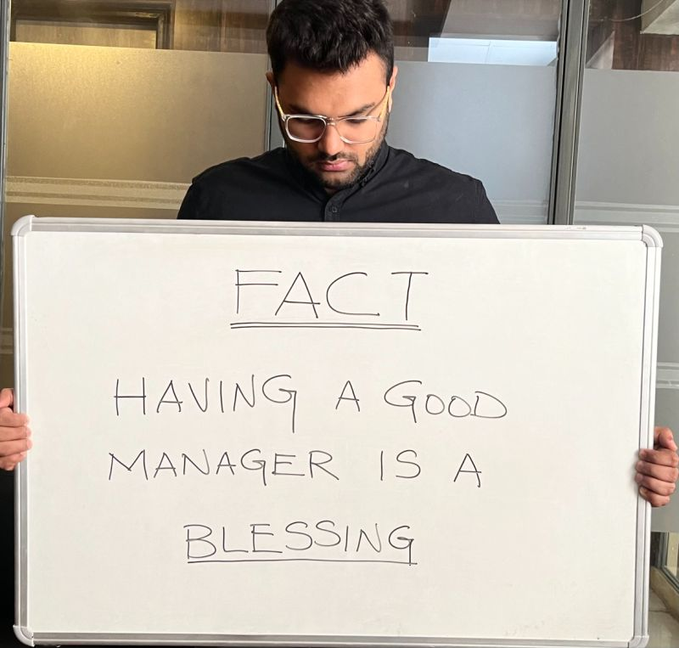
What is this all about?

Slide 6
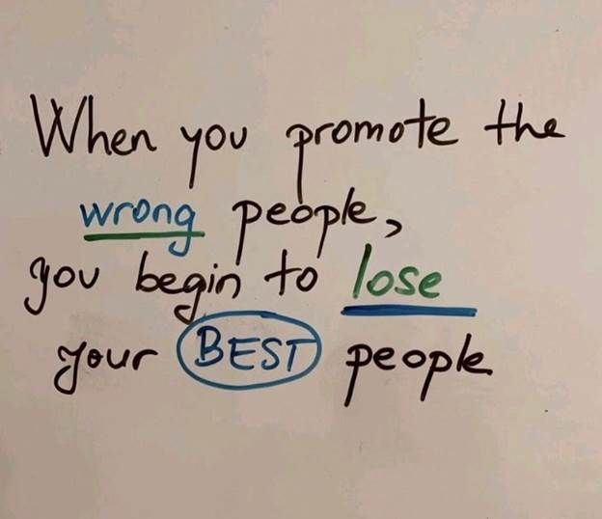
What is this all about…in words
Pressure on good managers is much higher than on good engineers
People are more complex entities than technologies
When you want to evaluate your manager, you need to find out one crucial peace of information:
How did he get his current position?

Slide 7
What is this all about…in words
From answer to this question you learn a couple of things…
What is his professional background in current company and in IT profession
What brought him to the current role - does he have a track record or was he “recommended”
Why did he leave his last position and did he leave voluntarily
Who is his sponsor
And…you know who to ask for his references...this is a small market and relevant information is only a few chat messages away
Networking is key to everything
And when you find a proper person to ask, be sure to get clear message across
Princess Bride, 1987

Slide 8
Motivation
I usually hold technical lectures – but this topic is too important to be ignored
This lecture is based on my experiences with one extremely toxic manager, mentioned in my correspondence as John Knucklehead, that degraded highly efficient team and still presents strong reputational risk to the company that, unfortunately, still employs him
Part of blame takes assigned HR partner, which avoided his responsibility to act, that I call Mr. Invisible, in fear of his position and career, who failed by not acting
Most people are afraid to discuss this topic because they are afraid for their careers
We will talk about;
What is and what is not toxic management
What are impacts to people, teams and companies
How do we recognize early signs and how we properly react on them
How to help such people
What we do if the person, even with our best efforts, doesn’t change

Slide 9
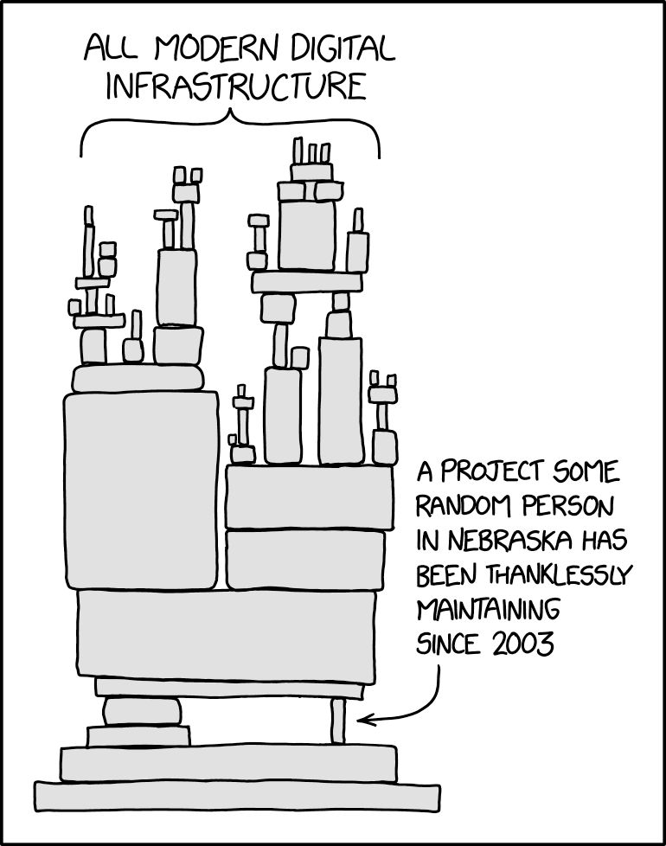
What is in for you
Deeper understanding of the subject
Learn how to recognize symptoms
Learn available strategies to deal with toxic managers
Increase self-confidence and your sense of self-worth
Initial understanding from the best – Simon Sinek: “Performance VS Trust”
https://www.youtube.com/watch?v=kJdXjtSnZTI

Slide 10
What do we do
Listen to some lectures…I do the work ☺
Take part in five small workshops…you do the work ☺
Fill an anonymous poll about toxic management impacts….you do the work…again ☺
We take some breaks and hopefully give you some takeaways

Slide 11
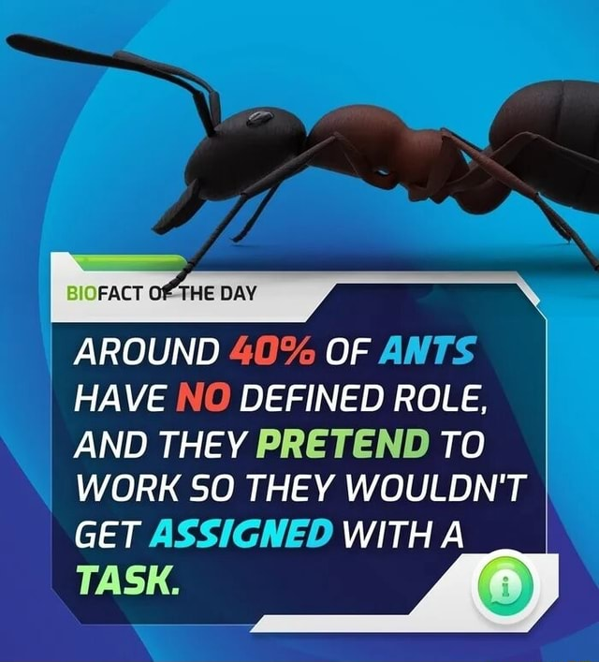
What is and what is not toxic management
Some behaviors might not be examples of toxic management
Everyone can have a bad day or bad week – almost anything can happen one-time
Sometimes managers are just doing what they are supposed to do…but in a very unprofessional way
Their actions could be enforcement of work rules and regulations…but in a very unprofessional way
Most people “think” they never met a toxic manager, but they might be wrong
You might not recognize symptoms – you probably already met a toxic manager

Slide 12
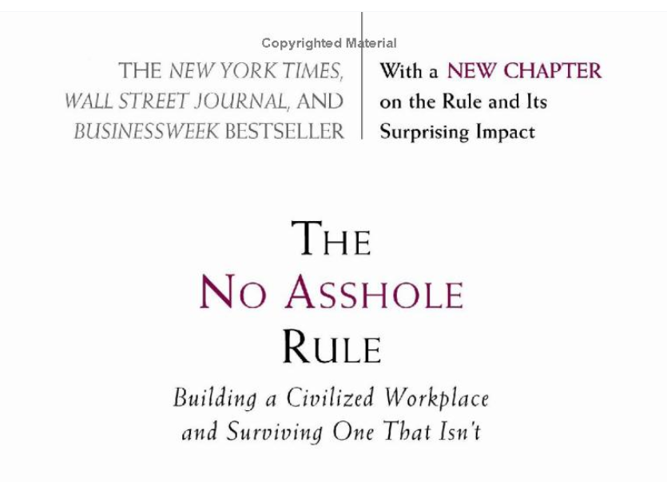
Some initial reading recommendations

Slide 13
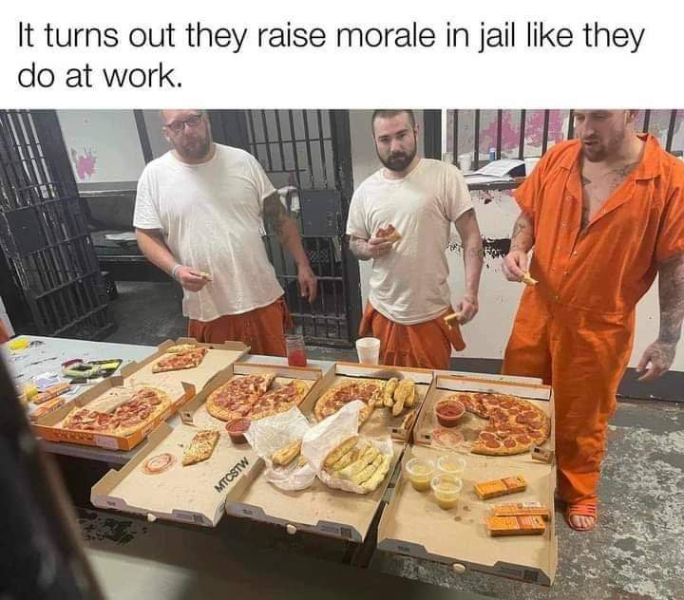
What is and what is not toxic management
When found, they need to be quickly handled, on all hierarchy levels and sizes, or it will result in:
Degradation of work quality, morale and stability of an organization
Causes high percentage of employee turnover combined with decrease in morale
Prolonged stress and loss of self-esteem of individuals or groups

Slide 14
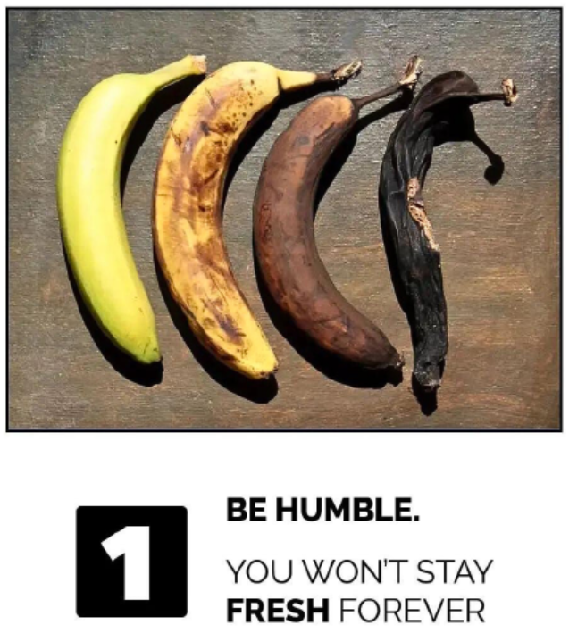
Workshop one – recognize signs of toxic managers and environments
Please divide in groups of equal number of people
Take 10 minutes to analyze key signs and then discuss between yourself and/or between groups
Some hints
Good work environment is not darts, fresh juices, pinball or fancy food
Smiling people in the office might not be a sign of healthy workplace
Learn to look beyond the surface – who got promoted and whether high loyalty is valued over high skill

Slide 15
Workshop one – recognize signs of toxic managers and environments
Take some time to do honest introspection for your work environment by following criteria:
Gossip and cliques
Managerial favoritism and bullying of others
Rampant absenteeism
Apathy, excuse-making and procrastination
Pessimism ( in relation to manager, not to work )
Avoiding communication with manager
Disorganization
Directive management style
Workaholics are “valued” and “you should look up to them”
Unethical promotion practices
Bad managers will say these things are caused by “bad or low-performing employees” or “too-restrictive social rules where they cannot fire low performers” but will have hard time explaining what they did do to grow people and will put personal estimate above measurable criteria

Slide 16
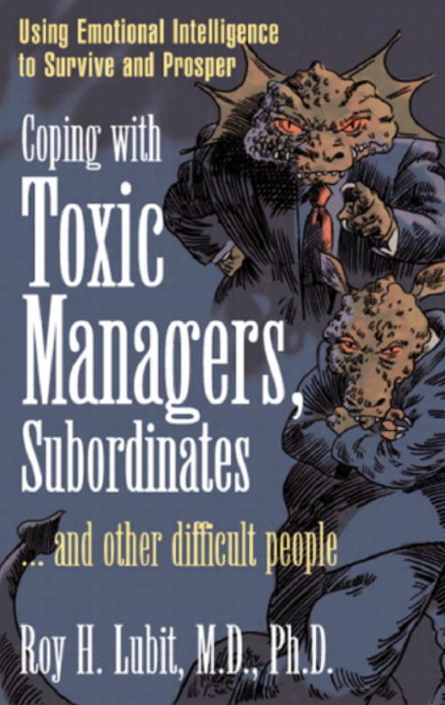
After workshop one - recommended reading

Slide 17
Emotional blackmail
Introduction to topic
https://en.wikipedia.org/wiki/Emotional_blackmail
“…controlling people in relationships and the theory that fear, obligation and guilt (FOG) are the transactional dynamics at play between the controller and the person being controlled. Understanding these dynamics is useful to anyone trying to extricate themself from the controlling behavior of another person and deal with their own compulsions to do things that are uncomfortable, undesirable, burdensome, or self-sacrificing for others.”
How many times did you hear sentences like…
“You promised…”
“We expected, can you make extra effort to help us…”
“What are your professional priorities…”
….

Slide 18
When we ignore problems…they don’t go away
Usual company response when toxicity is proven ( after you loose best people ):
“This never happened to us, we will investigate”
Managerial workshops start that should correct things ( they almost never do )
Blame is assigned to employees that are “lazy, unmotivated,…” and that didn’t “prove themselves” – though, on many occasions, their performance history was very good
When it is clear that some managers are inadequate they are hidden in subsidiary countries or positions of less visibility until “storm blows over”
If his sponsor would fire him individually he would need to explain why he hired him in the first place
When things really escalate companies start talking about “culture” and “we are all in this together”
Was agile transformation in corporates really “only” about agile?
Manager leaves the company, mid-managers will defend him because “management is hard”
C-levels think they solved the problem since, short-term, things improve
Key question was never answered – why this happened in the first place and what measures are implemented that this doesn’t happen again?

Slide 19
Workshop two – emotional blackmail
How it works
Stage 1 – Make unreasonable demands
“I don’t think you should …” without reason
Stage 2 – Resistance and push back
Not invited to meetings, skipped for projects
Stage 3 – Pressure
Faking their demand in a way that it looks favorable to you…”I am doing this for you…”
Stage 4 – Threats
Direct – “If you do this, I will…”
Indirect – “If I cannot trust you, maybe I find someone else whom I can…”
Weaker/less secure people comply
Out of fear of conflict or job security
If they don’t give in – cycle repeats

Slide 20
Workshop two – emotional blackmail
Stage 1 – Make unreasonable demands
Stage 2 – Resistance and push back
Stage 3 – Pressure
Stage 4 – Threats
Weaker/less secure people comply, otherwise cycle repeats
Workshop goal
Discuss real cases from your work history
If you feel comfortable, present them to the group

Slide 21
Toxic management characteristics
It is easier to find such individuals in larger companies where they can hide in numbers
No matter the company size…recurring and aggregating symptoms are the same
They are symptom of individuals' insecurity and desire to control environment in a way they believe is beneficial for them and those they perceive as friends
Although most people use terms “mobbing” and “bullying”…real problem is deeper
Toxic managers use different strategies on selected targets, which escalate over time
One clear sign of toxicity in managers is that their personal agendas take precedence over work and career path of his employees
These activities undermine business efficiency of individuals, teams and companies

Slide 22
Targets of toxic managers
Target are, usually, powerful and independent individuals, strong individual contributors and leaders
They replace them with people they can control and dominate, and that are, in some way, usually financially, less established
Early warning signs
People that are not psychologically stable get chipped away until they are mentally (and sometimes physically) broken
If that doesn’t work, invent half truths and situations to remove them in any way possible
Other methods include unattainable workloads and unachievable expectations as a form of psychological leverage, which, in the long run, can be an extremely powerful and destructive tool

Slide 23
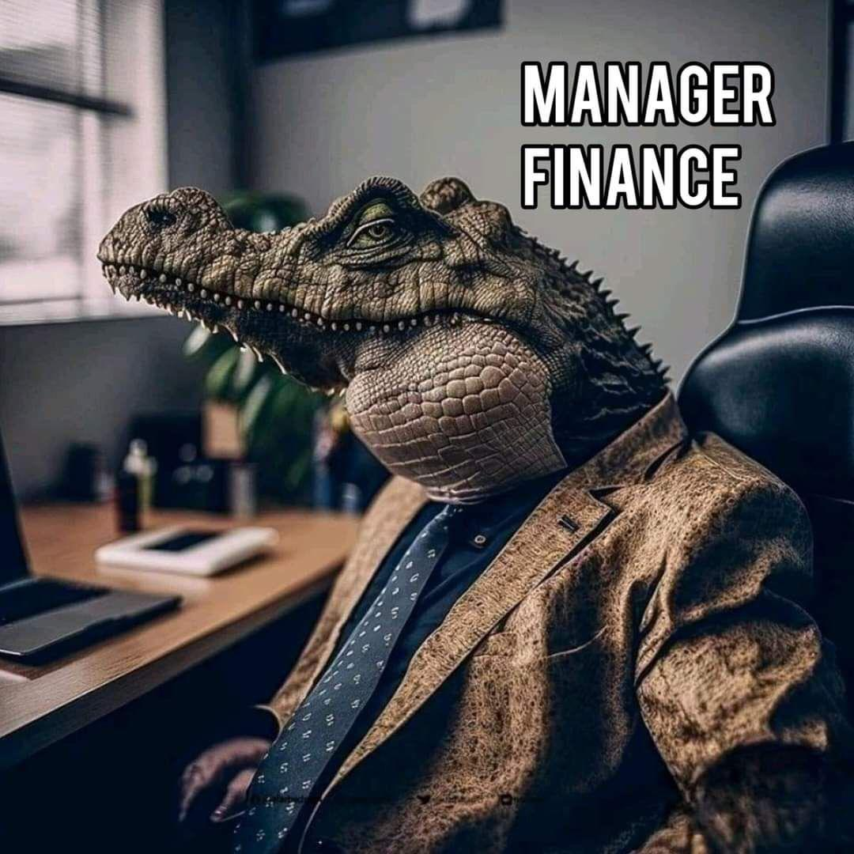
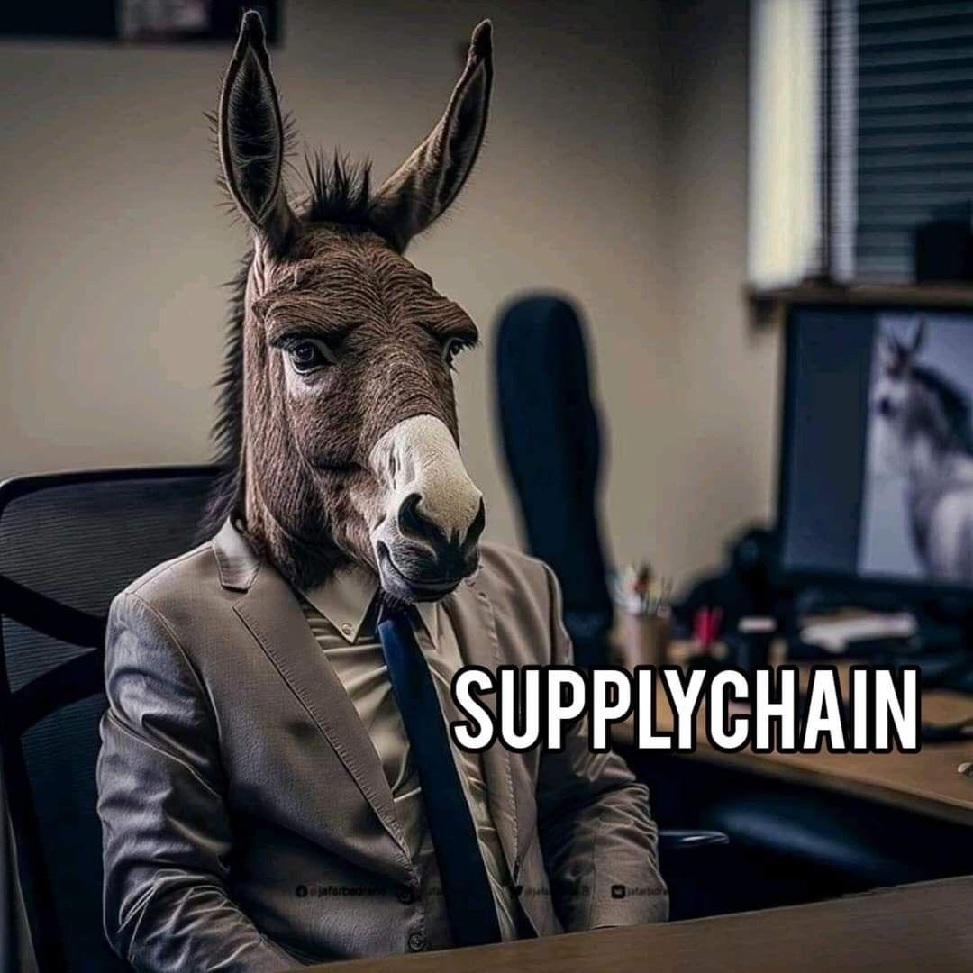
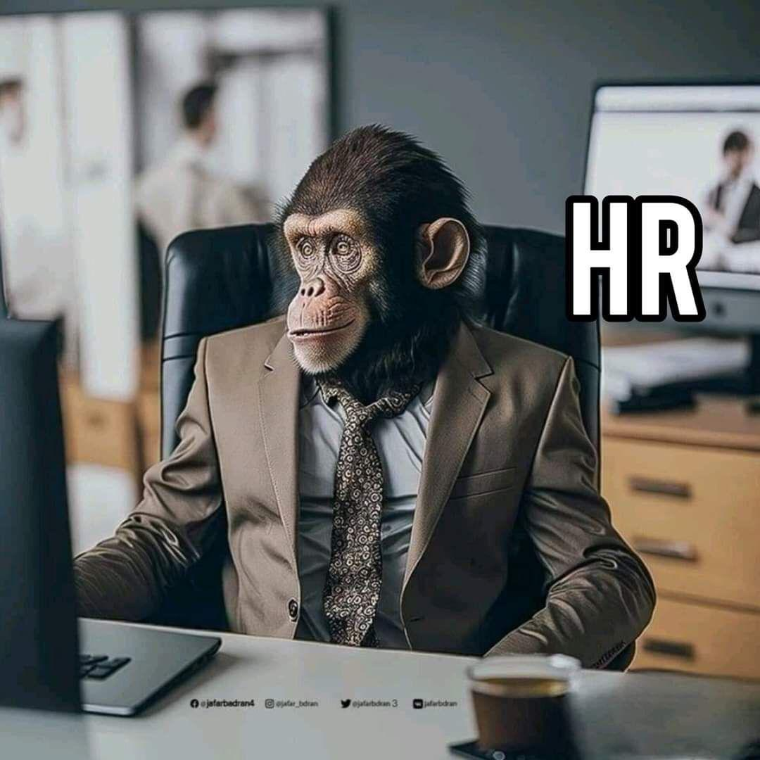
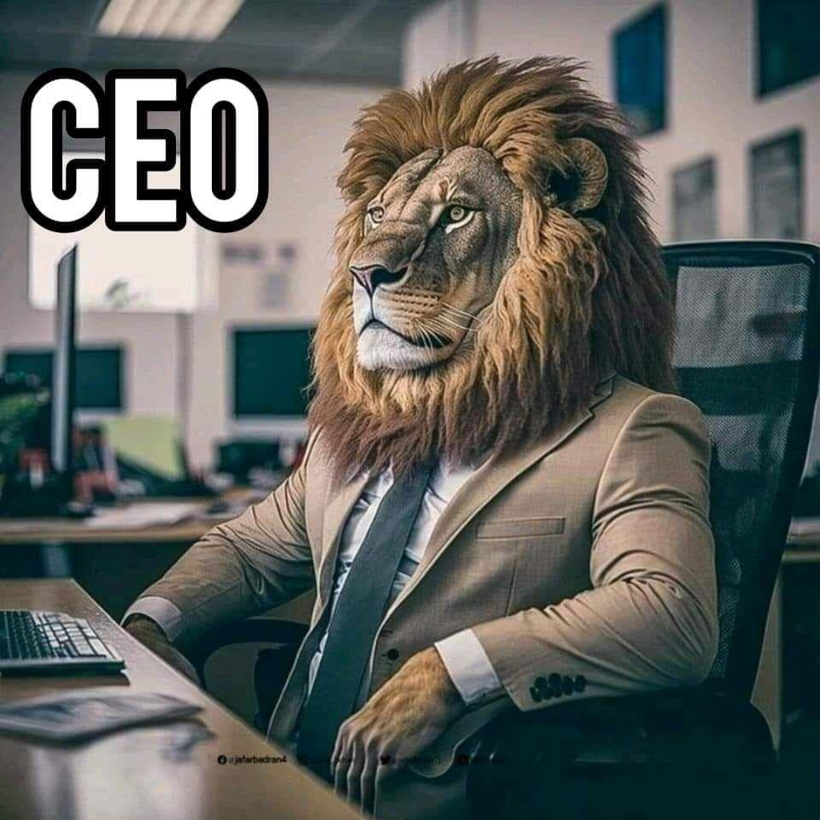
Targets of toxic managers
Everyone…
Stereotyping and generalizing is dangerous
“Because he is … “ doesn’t mean it cannot happen to them – you never know all the circumstances

Slide 24
Targets of toxic managers
Targeted individuals usually never had any performance or work delivery quality problems…until toxic manager took over the position
And then…overnight the situation changes
They can do nothing right and fast enough to earn a passing grade
Level of previous recognition is no longer attainable
Advancement is reserved for friends and people with less career options
These are clear signs of toxic manager

Slide 25
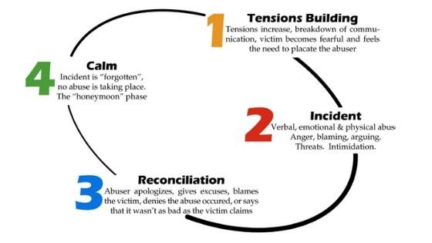
Workshop three – targets of toxic managers
Primary targets are, usually, high performers
In order to understand this we use cycle of abuse:

Slide 26
Workshop three – targets of toxic managers
Understanding cycle of blame answers why high performers are targeted
Correlation between a highly empathetic and/or co-dependent person and the tie to the toxic leader is based on a trauma bond.
Abusive or toxic people lead from a place of inner shame, insecurity, and fear - and this is why they abuse others
Co-dependent and/or empathetic people are consistently trying to make everything better, do more, please people, and work harder to improve the situation.
This becomes a never-ending dance that leaves the target exhausted, depressed, and experiencing physical and emotional distress.
The more the abusive boss targets the potentially co-dependent, high-performing employee, the harder that employee works. And so the cycle continues.

Slide 27
Workshop three – targets of toxic managers
Being the target of abuse is never, ever your fault, but you should be able to recognize it, helping us to:
Heal our own inner traumas
Gain the strength to create an exit strategy
Abuse affects every area of your life including your physical health, your ability to sleep, your memory, your stress levels, and your emotional well-being

Slide 28
Workshop three – targets of toxic managers
Take some time and think about example from your career where you were part of cycle of abuse
Workshop goal
Discuss real cases from your work history
If you feel comfortable, present them to the group

Slide 29
Characteristics of toxic managers
Toxic manager lives in a black and white world
It is only about his career and benefit – if he ever says “what is in it for me if I give you this…” you can be quite sure you work for toxic manager
Their technical knowledge, in the organizational area he manages is, quite often, average – though this might not be a clear indicator
When they get what they want by any means at their disposal, sometimes going over boundaries of legality and good business practice, they show this as their achievement in decrease of cost or increase in efficiency
They’re the perfect blend of arrogance and ignorance

Slide 30
Characteristics of toxic managers
Frequently observed patterns:
Supervision by fear and intimidation
Micromanagement
Arrogance and rigidity
Lack of employee growth/progress, except “people they trust”
Hiding personal incompetence and inadequacy behind a mask of “seriousness”
Brought by “recommendation” of higher manager, need to “prove loyalty and obedience”
There’s high employee turnover and rumors in the company
Sign of a non-toxic manager:
Employees look forward to show up for work every day

Slide 31
Characteristics of toxic managers
Toxic leadership can cause workplace bullying, counterproductive work behavior, job dissatisfaction, psychological distress and burnout
If it continues over time, stress increases and it leads to significant work and social behavioral change,
Such managers then use this to get rid of such employees with the false excuse that “they are not adequate or he cannot find them work”
Employees are more likely to retaliate and redirect their frustrations at others around them instead trying to solve the situation

Slide 32
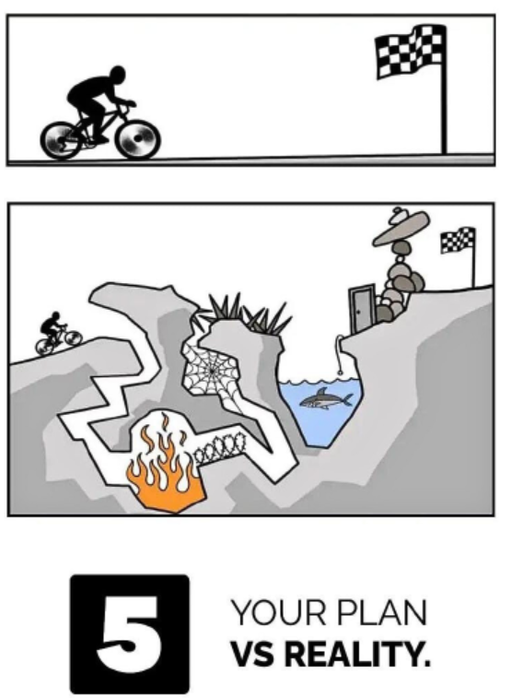
Workshop four – detect toxic manager
Top signs of a toxic boss
Favoritism is apparent, specially national
Only advancing careers they “trust and have proven themselves to them”, no matter what is reality
Feedback, if provided, is ( mostly ) only about things that benefits their careers, not employee career growth
Avoid topics of career path as much as they can
With their behavior create gossips and conflict
Publicly criticize people and micromanage
They try to use fear of job loss, special to people which are dependent on salary ( which is most people )
…
Workshop goal
Discuss real cases from your work history
If you feel comfortable, present them to the group

Slide 33
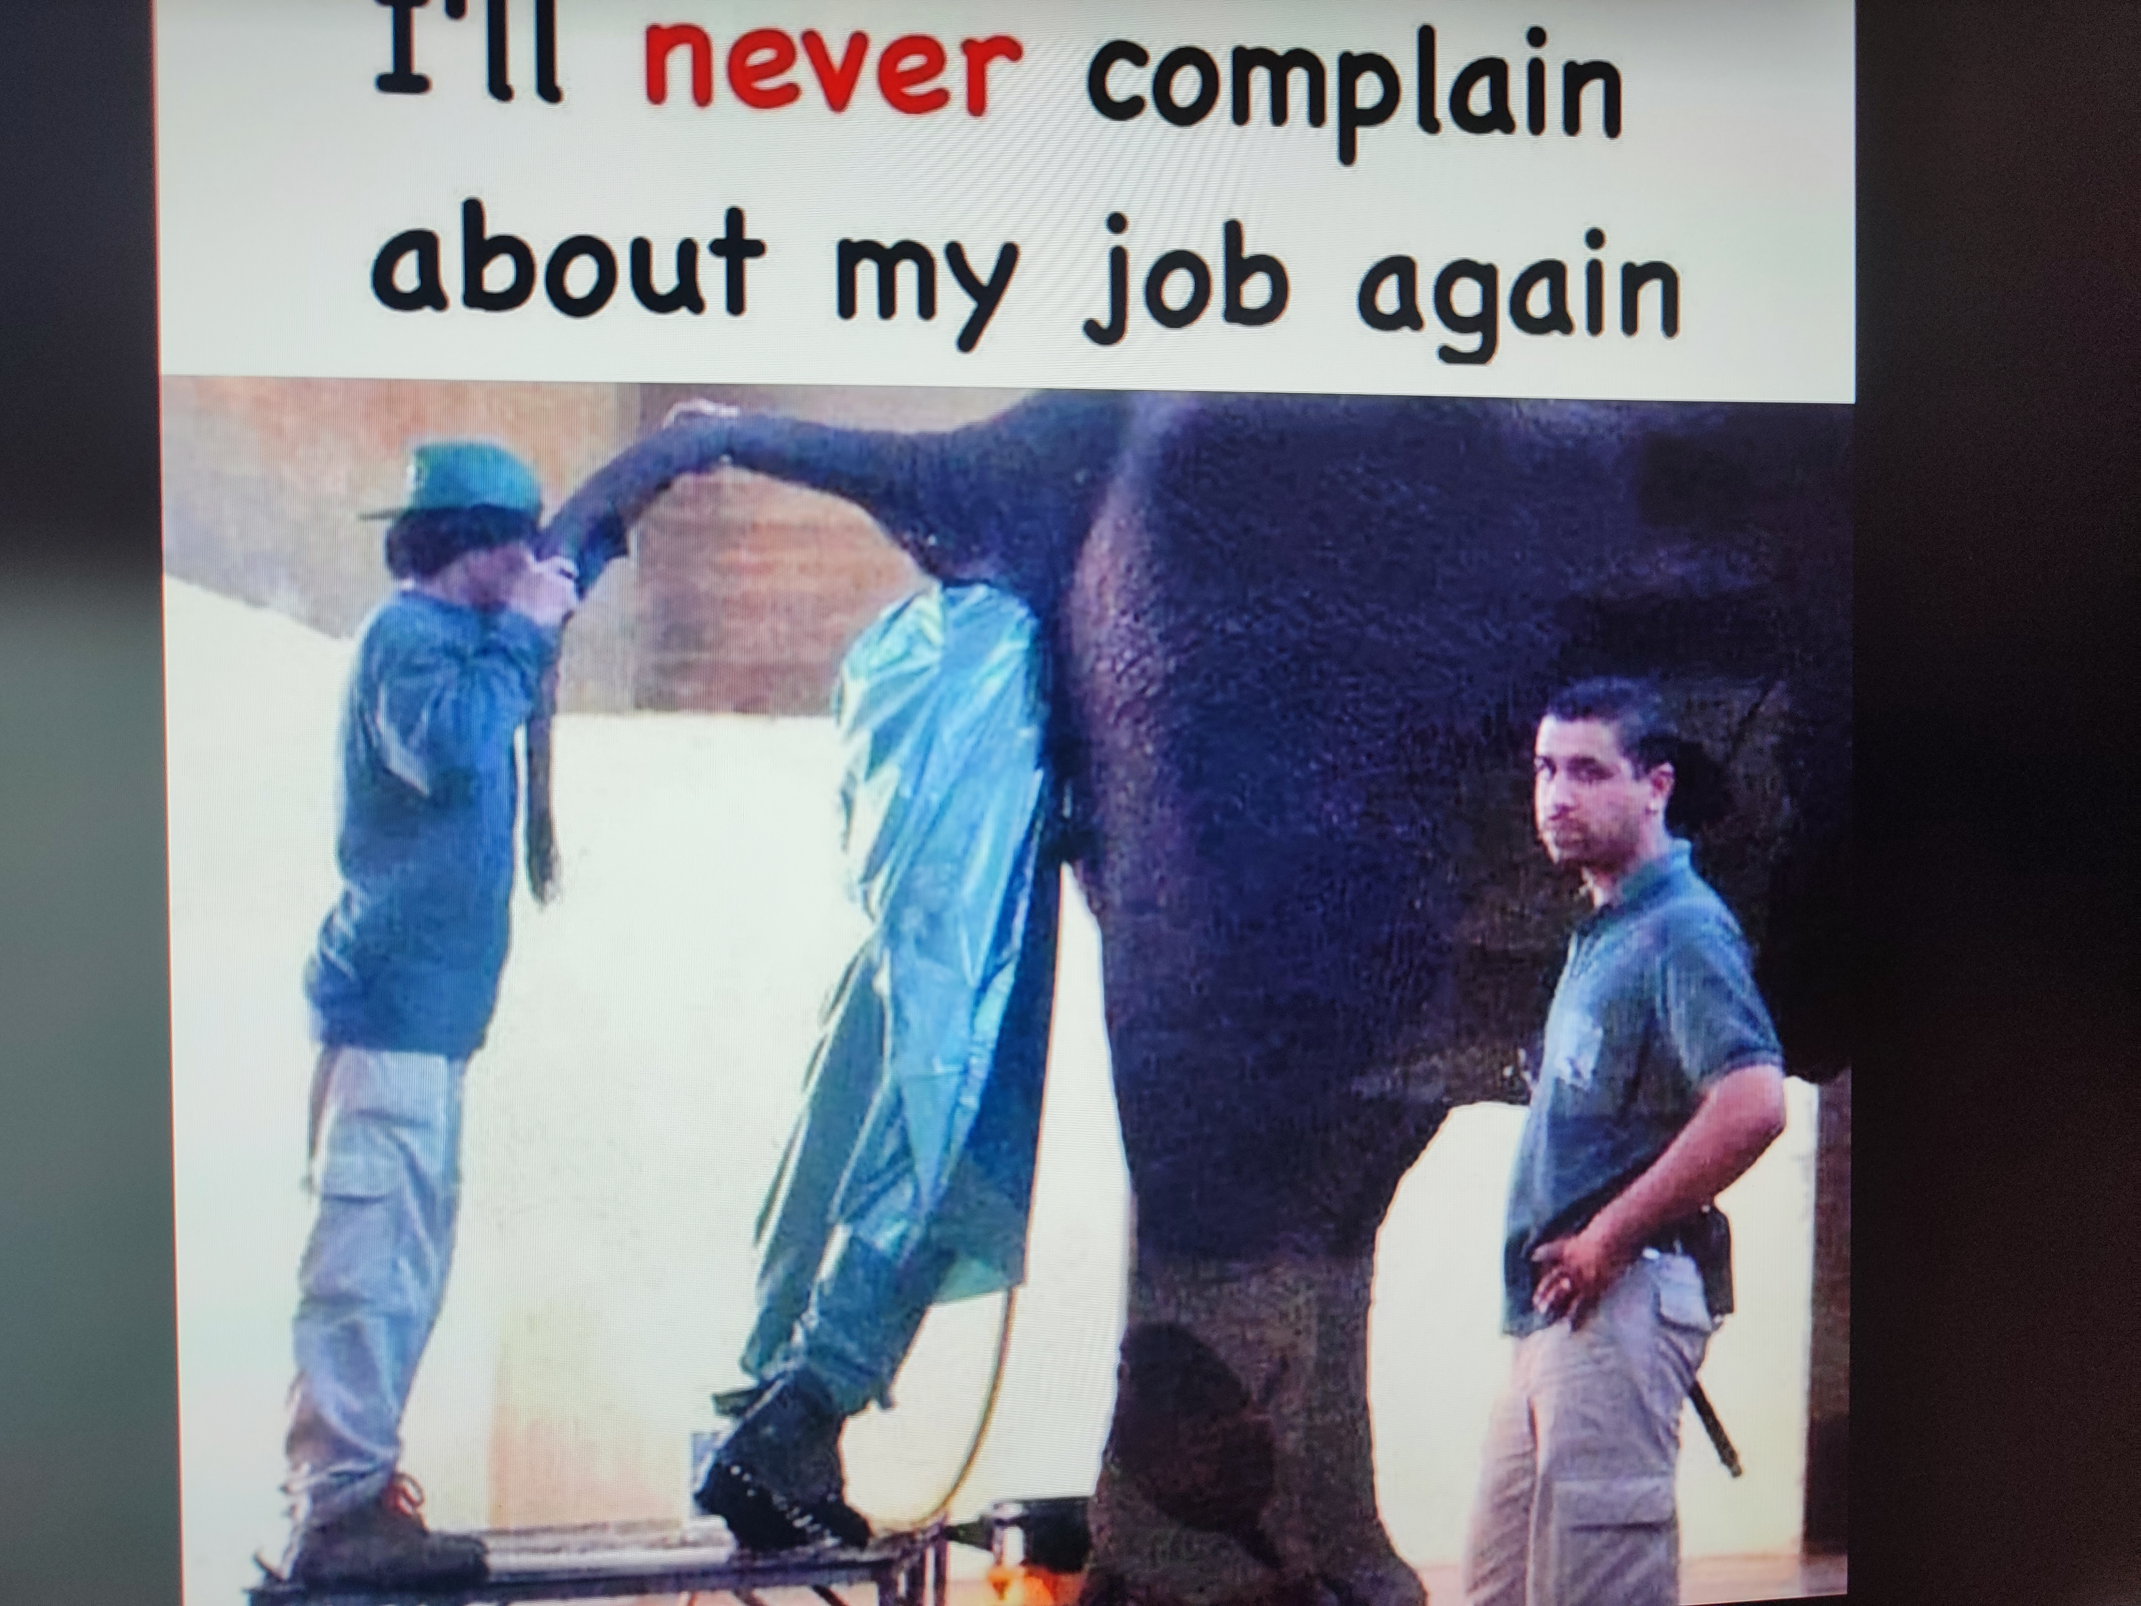
What can we do?
Sometimes all is not lost…
If this is just temporary occurrence, maybe the person is not aware, and honest feedback will help
This is a very rare case
You can ask for help, but you must be careful who you ask
Start preparing company/project exit plan

Slide 34
What can we do?
It is hard to “stand-up” to such people, and pressure is on employees due to the formal authority of such managers and the need for the job and monthly income
Conflict with a manager could seriously impact your career advancement opportunities in that company
It is not easy to be the first person to stand up to a toxic leader, and, as result, toxic leaders often get tolerated for long periods of time
Sometimes you can deal with such people, and if no one will ever speak out, the problem won’t be resolved.
Fear of standing alone is exactly why several people in a team often tolerate toxic behavior
Toxic leaders might not be inherently bad people, although most are
They may not realize what they are doing and it could be a defense mechanism
They realize their technical and managerial inadequacy to the position they were given
“Impostor syndrome” is heavily present in these people, though they will try to hide it as best as they can

Slide 35
What can we do?
As humans, we should attempt to help instead of judge, and keep control of your reactions
You can’t control how your manager acts, but you are in control of your reactions to those actions - staying in control of your emotions and not giving them the attention they feed on
Keeping distance to that person helps you in the short term, but in the long period you need to discuss this in wider environment
You need to document everything that goes above normal professional behavior
The more toxic is the manager, value of his estimates on your work or performance declines, and his opinion is less valid
An employee's job is not to “prove themselves” to a toxic manager
If things do not improve – start looking for transfer or new company or your career, and sometimes health, will be impacted

Slide 36
Workshop five – confronting toxicity
First you need to recognize type of manager
Cold manager (uses all possible means to achieve their goals )
Snake manager (obsessed with greed and power and he uses the world to meet their personal needs )
Glory seeking manager (craves attention and their glory at all costs, regardless of whether they have taken part or not )
Puppeteer manager ( control freak )
Notes:
The cold manager is also called the cold fish and he uses all possible means to achieve their goals. This type of management shows no emotional intelligence or empathy in the work environment. Their personal life is dominated by feelings and emotions, whereas their professional life is dominated by rationality. This creates an overload of work that burns out the employees and it exhausts them. They tend not to focus on innovation management and this discourages creativity in the workplace. Also, the mental health and physical health of the employees are of no interest to him.
He is a manipulator, he sets unrealistic goals and these are from his lack of humility.He would do anything to gain all the fame, including taking all the merits and showing off himself. This type of management style has no room for employee initiatives and in a holocracy, they will still take all the credit. A glory seeker manager celebrates the employees’ success, but it is entirely on them when they are at fault

Slide 37
Workshop five – confronting toxicity
Monarch manager (monarch manager dominates the entire organization with their ideas and they create a dictatorship that leaves no room for collective intelligence; additionally uses direct and indirect threats )
The incompetent manager (These bosses care about employee development but are not always present to provide leadership, coaching or support )
The micromanager (obsessed with closely monitoring every element of their staff’s work and is controlling even in the digital culture )
Notes:
He never admits his mistakes. He is omnipresent and does not trust his staff
In remote management, employees are used to absentee bosses, but it will be difficult to get a hold of if there are questions or feedback that need to be addressed.
How to deal with an incompetent manager - you need to adapt to their schedule and ensure effective communication. Since they don’t respond to emails, ensure that you stick to one topic and use easy-to-read points. Instead of sending them an email, it is better to schedule a 15-minute video chat with them.
The micro manager
A micromanager is obsessed with closely monitoring every element of their staff’s work and is controlling even in the digital culture. A micromanager tends to act like this because they think the employees are not accountable and they cannot deliver the desired quality or quantity of work. Conversely, employees feel they are not empowered or trusted enough for them to do their best.
Dealing with a micromanager - Those who work independently find a micromanager boss to be frustrating. To deal with a micromanager, you should start by slowly gaining their trust by giving frequent updates and ensuring you are delivering your promises. With time, they will begin trusting you and loosening their grip.

Slide 38
Workshop five – confronting toxicity
How to deal with toxic managers ( high level ):
Recognize the nature of toxic manager
Open the discussion
Try to discuss if something can be done ( coaching ? )
If all else fails…leave…and spread word ☺
Workshop goal
Discuss real cases from your work history
If you feel comfortable, present them to the group
https://www.coachhub.com/blog/what-is-toxic-management/#how-to-recognize-a-toxic-manager?

Slide 39
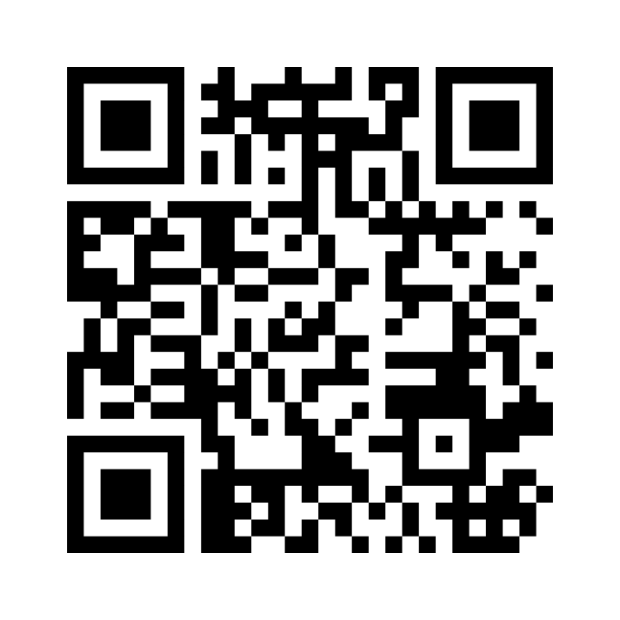
Quick survey
https://www.menti.com/aleuwqyo4kxx

Slide 40
Further reading
Simon Sinek ( most videos ☺ )
Gary Chapman, Paul White - Rising Above a Toxic Workplace - Taking Care of Yourself in an Unhealthy Environment
Kusy Mitchell, Holloway Elizabeth - Toxic workplace! - Managing toxic personalities and their systems of power
Lynne Curry - Beating the Workplace Bully - A Tactical Guide to Taking Charge
Robert I. Sutton - The No Asshole Rule - Building a Civilized Workplace and Surviving One That Isn’t
Susan Forward, Donna Frazier - Emotional Blackmail - When the People in Your Life Use Fear, Obligation, and Guilt to Manipulate You
Roy H. Lubit - Coping with Toxic Managers, Subordinates ... and Other Difficult People

Slide 41
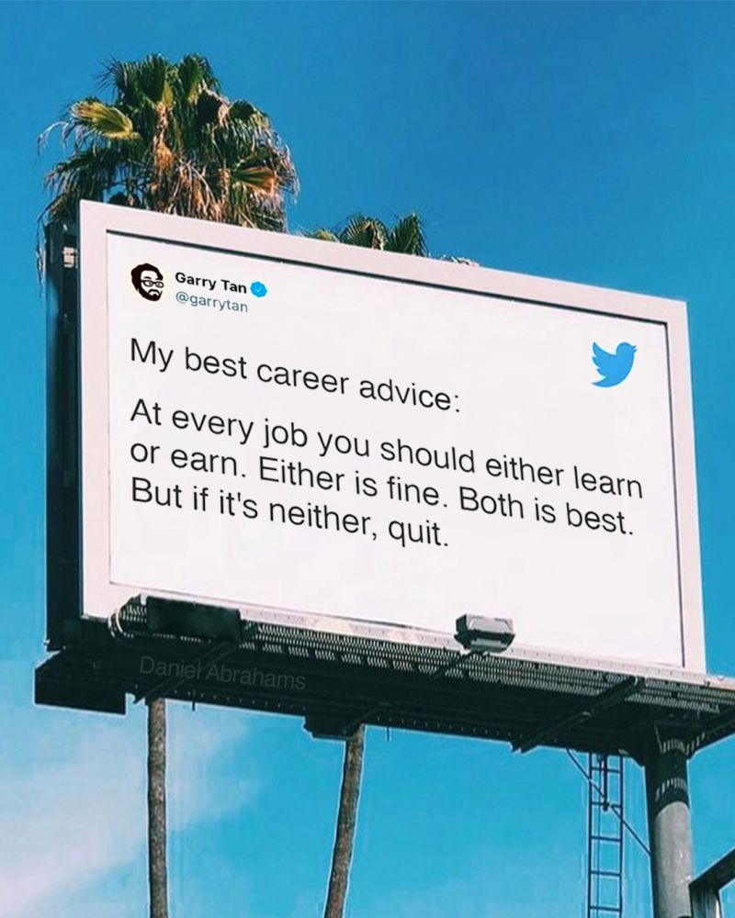
Final thoughts

Slide 42
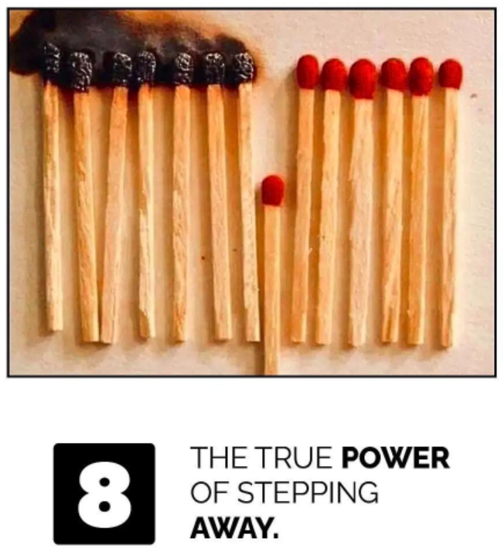
Discussion, Q&A
Contacts:
https://at.linkedin.com/in/josipsaban
josip.saban@meridian-data.hr
Let’s do coffee later, and maybe think about coming to my Snowflake lecture tomorrow ☺

