Slide 2
Notes:
Sponsors

Slide 3
gamification - license to game
Notes:
Title & Name

Slide 4
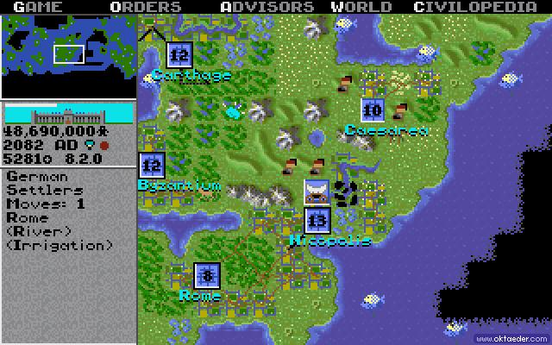
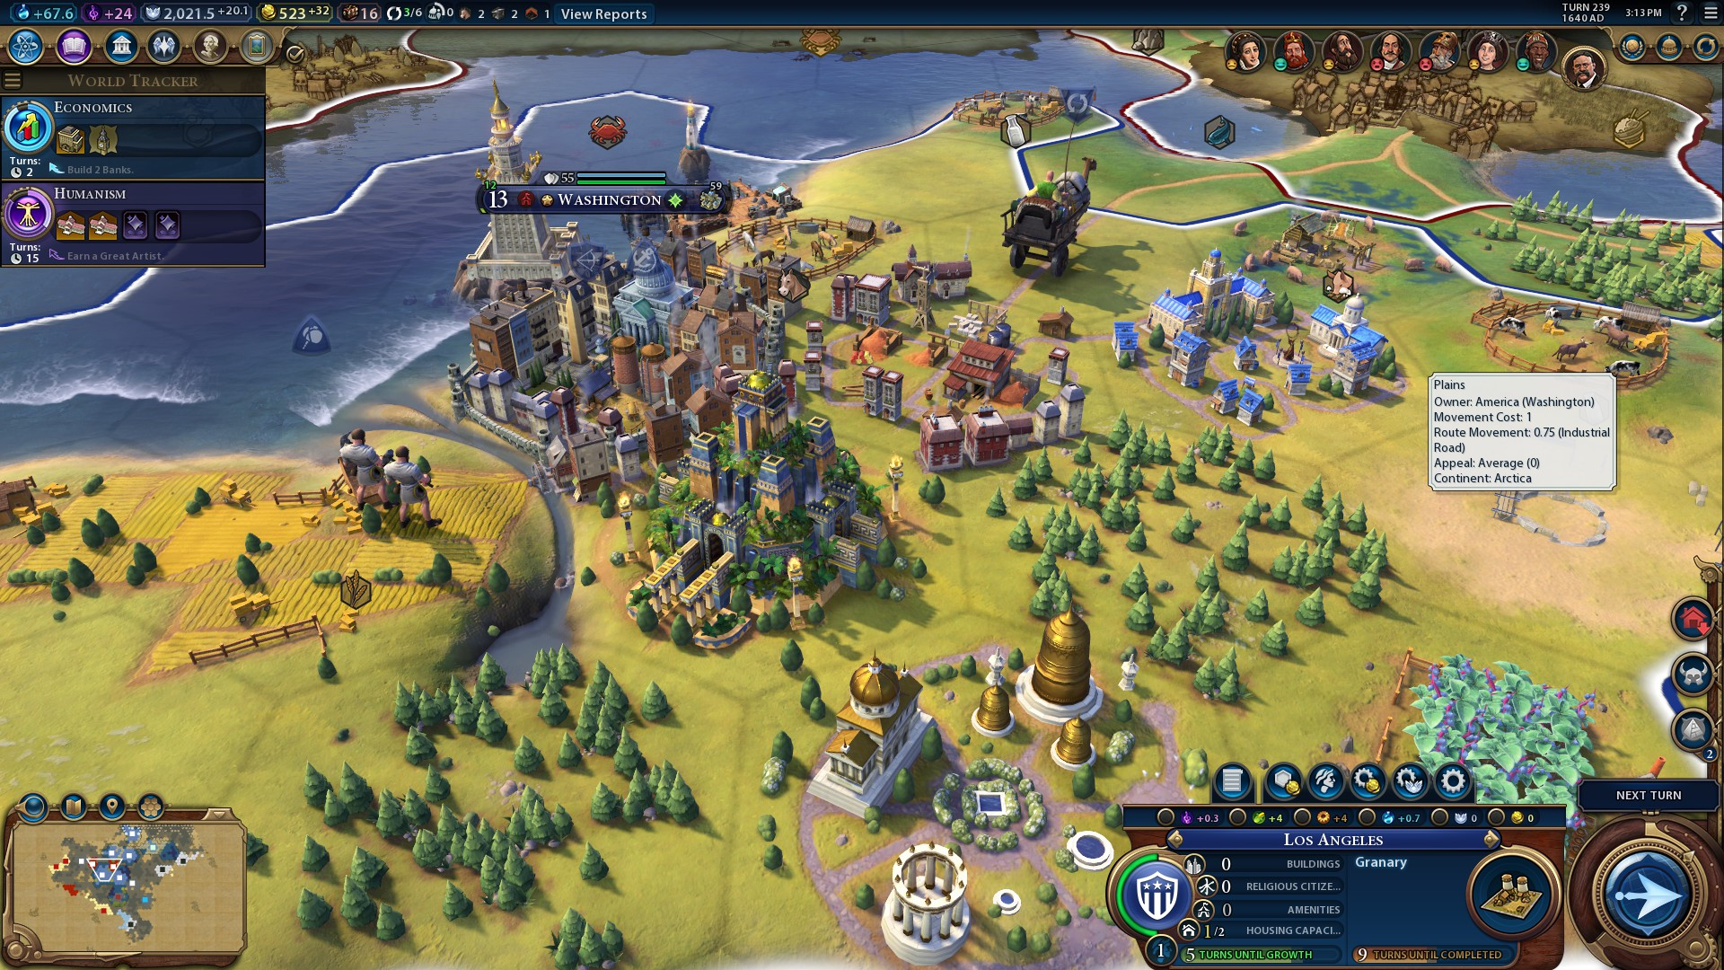
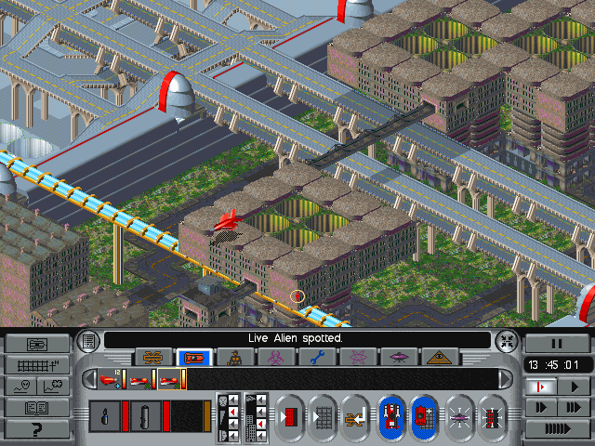
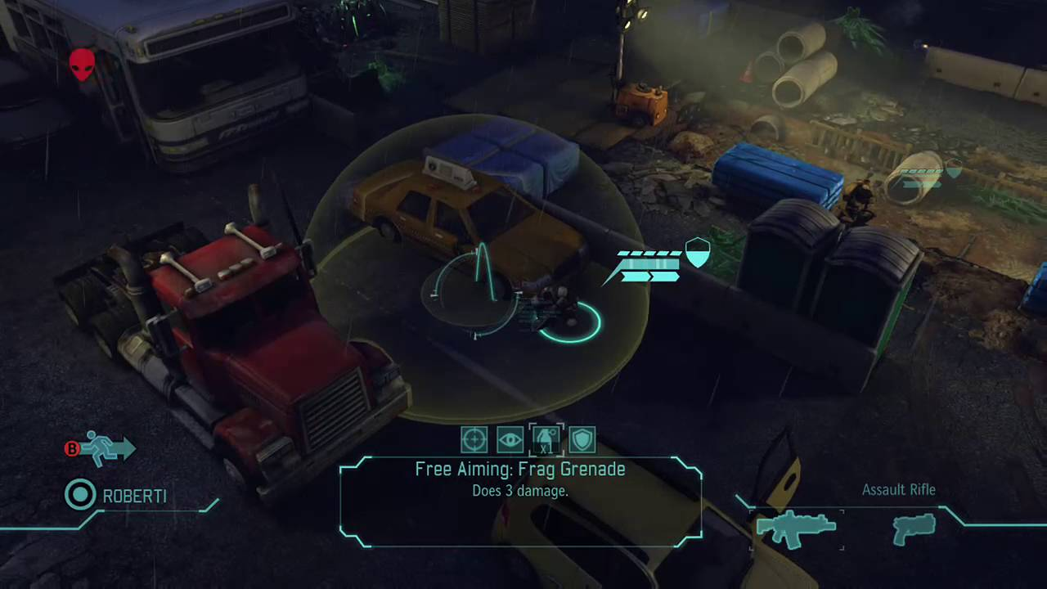
Geek factor detection system

Slide 5
From gaming to working

Slide 6
Gamification is the use of game elements and game design techniques in non-game contexts.

Slide 7
Game Elements
Points
Resource Collection
Levels
Progression
Quests
Avatars
Social Graph

Slide 8
Game Elements
Progression
Levels
Points
Rewards
Quests
Avatars
Social Graph
Badges

Slide 9
WHO IS GAMIFYING AND WHY?
Microsoft
Nike
SAP
American Express
Major League Baseball
Salesforce.com
AXA Equitable
CodeAcademy
Deloitte
Samsung
EMC
Foursquare
Stack Overﬂow
USA Networks
LiveOps
Dell
Kaiser Permanente
Foot Locker
Opower
eBay
Cisco
Recyclebank
Universal Music
Siemens
Yelp
Verizon
An emerging business practice
Games are powerful things
Lessons from psychology, design, strategy, technology
Harder Than it Appears!

Slide 10
Down the road…
1980
TODAY

Slide 11
HIDDEN MESSAGES
External
Marketing
Sales
Customer engagement
Internal
HR
Productivity enhancement
Crowdsourcing
Behavior change
Health and wellness
Sustainability
Personal ﬁnance
Avatars
Points
Rewards
Badges
Challenges
Leaderboard
Overall trafﬁc on the USA Network site increased 30%
Online merchandise sales increased 50%
Pageviews increased 130%
Psych content shared 300,000 times on Facebook, reaching 40 million users.

Slide 12
WINDOWS 7 LANGUAGE QUALITY GAME
4,500 participants
Reviewed over 500,000 dialog boxes
6,700 bugs reported
Hundreds of signiﬁcant ﬁxes

Slide 13
SPEED LIMIT ENFORCEMENT
Gamiﬁcation can motivate
Applications in many domains
– External, internal, behavior change
Encompasses many techniques
Average speed in Stockholm trial decreased from 32 to 25 kmph.
http://www.youtube.com/watch?v=iynzHWwJXaA

Slide 14
Gamiﬁcation is Not…
“Making everything a game”
– …or an immersive 3D virtual world

Slide 15
Gamiﬁcation is Not…
Any games in the workplace

Slide 16
Gamiﬁcation is Not…
Simulations (although they may constitute serious games)
Pulse!! (developed at Texas A&M-Corpus Christi)

Slide 17
Gamiﬁcation is Not…
Just for marketing or customer engagement
Just PBLs (points, badges, leaderboards)

Slide 18
Gamiﬁcation IS…
Listening to what games can teach us
Learning from game design (and psychology, management, marketing, economics).
Appreciating fun.
Sebastian Deterding, et al, From Game Design Elements to Gamefulness: Deﬁning “Gamiﬁcation”, Mindtrek 2011 Proceedings, at bit.ly/o6aX1U

Slide 19
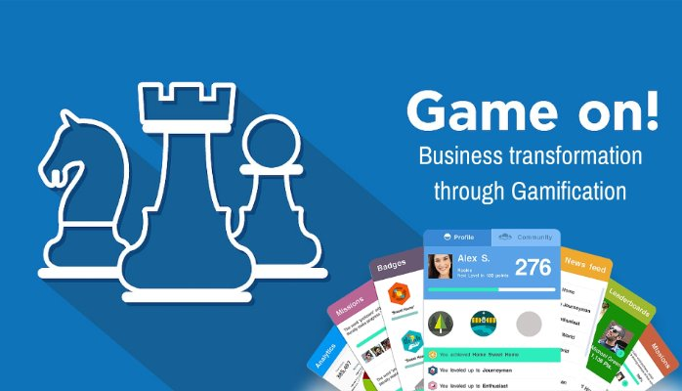
Be a part of this story…

Slide 20
…but how?

Slide 21
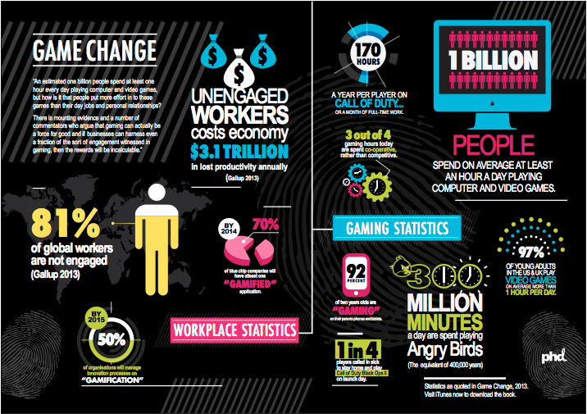
…and who is doing it?

Slide 22
…and who is REALLY doing it?

Slide 23
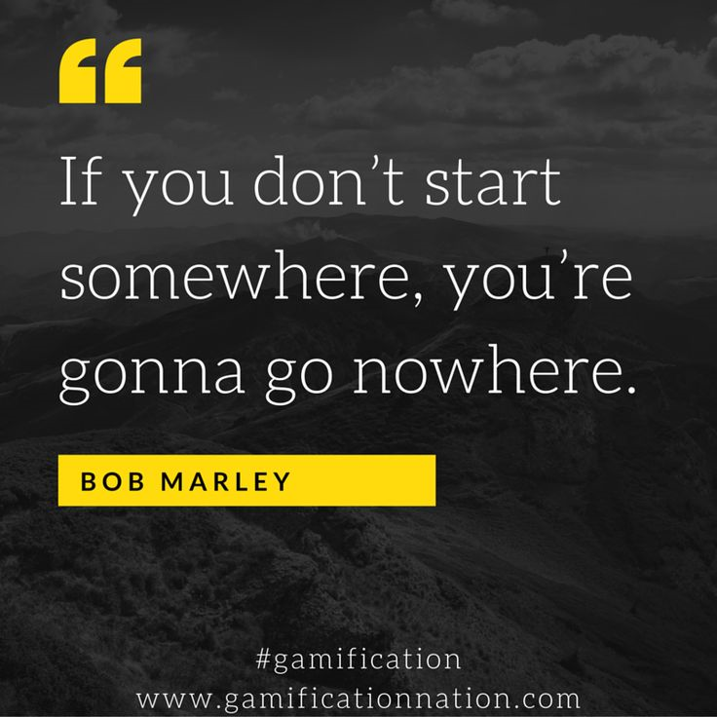
Where to start?

Slide 24
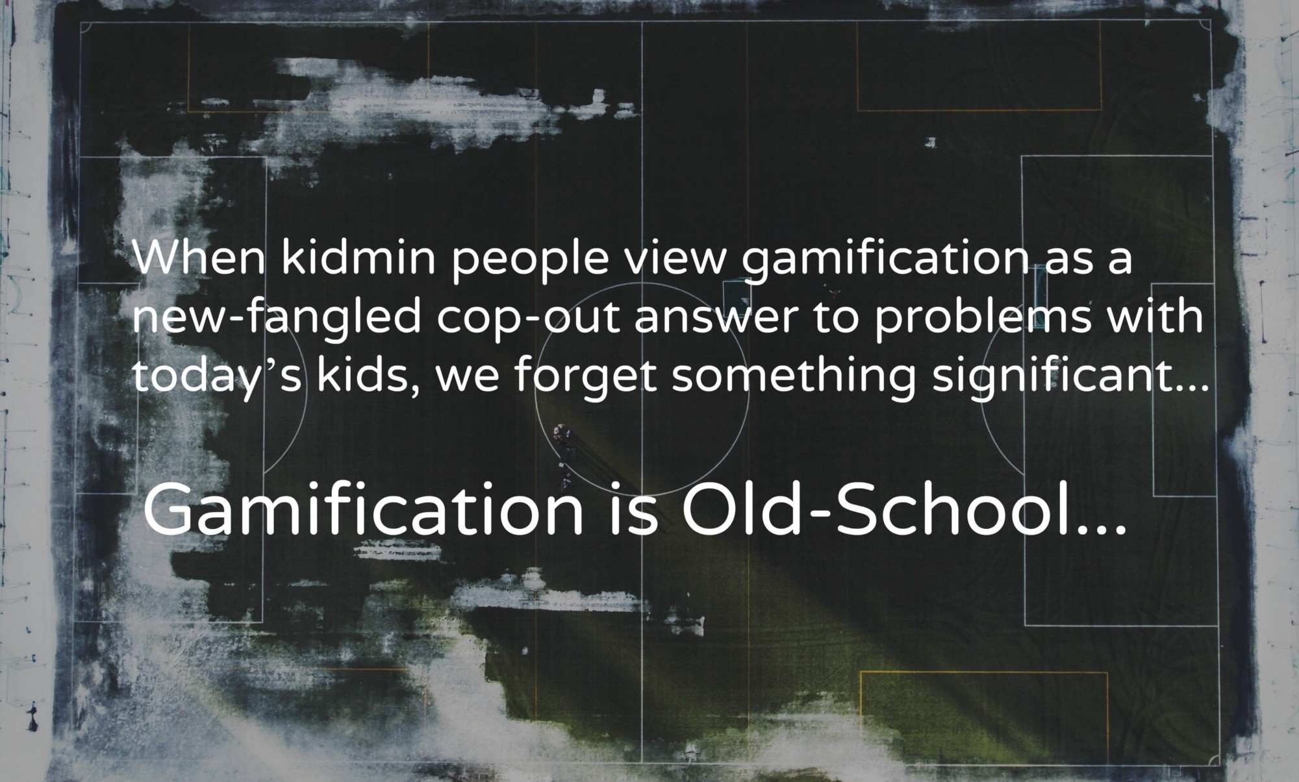
Where to end?

