Slide 1
Data visualization Introduction Matplotlib + Seaborn Further development
Josip Saban, M.Sc., MBA
KULENDAYZ 2021

Slide 2
Welcome ( dobrodošli ☺ )
Introduction | Applied visualization | Next steps
Human visual perception | Finding the story in your data | Online courses
Basic data visualization lessons | Best practices in data design | Literature
Graphical form | Matplotlib + Seaborn ( with examples ) | Q&A
Graphical integrity
Dashboards
INTRODUCTION
Applied visualization
NEXT STEPS
60 minutes
15 minutes
Break - 15 minutes
60 minutes
Break - 15 minutes
60 minutes
15 minutes

Slide 3
About me
2004 - Master of Science on University of Zagreb, Faculty of Electrical Engineering and Computing, Croatia
2010 - 2011 – MBA on Cotrugli, Zagreb, Croatia
2021 – 2023 ( exp. ) – TU Wien, MBA - Innovation, Digitalization & Entrepreneurship
2004 - … - over 40 technical certifications, 30+ Coursera courses/specializations ( agile, visualization, management ), PMP, ITIL, SAFE
Worked in private sector in external and internal roles
Co-owned one startup
Holding public lectures, writing blogs
Tableau coach, PowerBI expert, data visualization fan
Passionate reader of books
Tennis and soccer fan, ITF tennis judge
Currently working in DWH stream, Erste Digital, Vienna

Slide 4
Contacts
Josip Saban
josip.saban@erstegroup.com
josipsabanbusiness@gmail.com
https://www.linkedin.com/in/josipsaban/
https://jsaban.github.io/

Slide 5
Before we begin…motivation
Data visualization is an important skill in applied statistics and machine learning.
With a little domain knowledge, data visualizations can be used to express and demonstrate key relationships in plots and charts that are more visceral to yourself and stakeholders than measures of association or significance.
Data visualization is a separate field by itself and requires much deeper research to master than this course can provide.

Slide 6
Introduction
Human visual percepetion
Basic data visualization lessons
Graphical form
Graphical Integrity
Dashboards

Slide 7
Human visual percepetion

Slide 8
Introduction
To use and communicate using visual perception, you must understand its rules
Effective visualization is a product of proper design

Slide 9
Introduction
Most powerful sense is visual
To display data effectively you must understand visual perception
What works?
What doesn’t work?
Why it works?
Today I will discuss only a very small part - pattern principles of visual perception

Slide 10
Visually Encoding Data for Rapid Perception
Pre-attentive processing is tuned to detect a specific set of visual attributes
Attentive processing is sequential, and therefore much slower
Let’s demonstrate...

Slide 11
Twenty second test...how many five’s in the list ( attentive processing )
9813347899349533489928429238483911298498998
98134123412388239146100913280953891208955131
1234123932304912088679786541298048195231314
1231244123498415267825128387651458911989213
13049128517642149128094932455788812387192835

Slide 12
Twenty second test...how many five’s in the list ( pre-attentive processing )
9813347899349533489928429238483911298498998
98134123412388239146100913280953891208955131
1234123932304912088679786541298048195231314
1231244123498415267825128387651458911989213
13049128517642149128094932455788812387192835

Slide 13
Twenty second test...review
“Fives” could easily be distinguished from the other numbers, due to their differing color intensity
We had difficulty with first set because the complex shapes of the numbers are not attributes that we perceive pre-attentively
Simple shapes such as circles and squares are pre-attentively perceived, but the shapes of numbers are too elaborate
Pre-attentive attributes of visual perception can be organized in four categories - color, form, spatial perception and motion

Slide 14
Encoding Quantitative Versus Categorical Data
While some attributes allow us to perceive one thing as greater than others in some way (bigger, taller, more important), others merely indicate that items are distinct from one another, without any sense of some being greater than or less than others
It is obvious that the circle on the right is bigger than the circle on the left, but how much bigger?

Slide 15
Pattern principles of visual perception
We will discuss some of perception principles
Proximity
Closure
Similarity
Enclosure

Slide 16
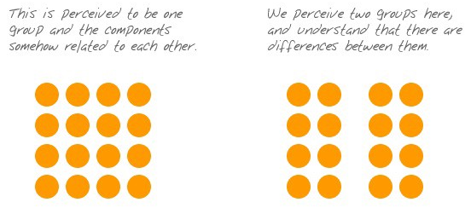
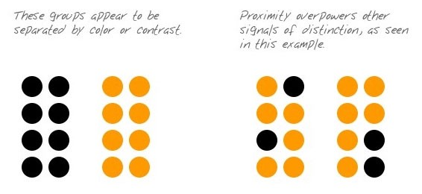
The Principle of Proximity
We perceive objects that are located near one another as belonging to the same group
This is the simplest way to link data that you want to be seen together
White space alone is usually all you need to separate these groups from the other data that surrounds them

Slide 17
The Principle of Closure
We, as humans, have a keen dislike for loose ends
When faced with ambiguous visual stimuli, objects that could be perceived either as open/incomplete/unusual or as closed/complete/regular, we naturally perceive them as the latter

Slide 18
The Principle of Similarity
We tend to group together objects that are similar in color, size, shape, and orientation
The principle of similarity applies very effectively to groups of visual objects that vary as different expressions of pre-attentive attributes
It works especially well as a means of identifying different data sets in a graph (for example, income, expenses, and profits)

Slide 19
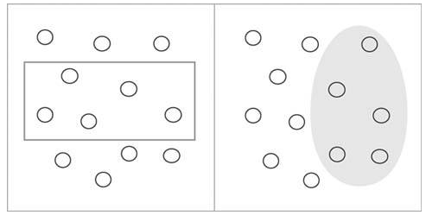
The Principle of Enclosure
We perceive objects as belonging together when they are enclosed by anything that forms a visual border around them
This enclosure causes the objects to appear to be set apart in a region that is distinct from the rest of what we see

Slide 20
Closing thoughts
Vision is fast, reason is slow
Human brain is natural cartographer
Seeing, perceiving, and knowing are not the same thing
Vision is the result of mapping your environment based on the aggregated information your eyes obtain from multiple fixations
They are attracted first to certain features before they move to others…they prioritize

Slide 21
Closing thoughts
Based on this - you should never simultaneously show an animation or picture on the right side and a textbox on the left
Same is for color - the best way to disorient your readers is to fill your graphic with objects colored in pure accent tones
Pure colors are uncommon in nature, so limit them to highlight whatever is important in your graphics, and use weaker hues for everything
Conclusion: If you know that the brain prioritizes what it pays attention to, prioritize beforehand

Slide 22
Basic data visualization lessons

Slide 23
Introduction
We discuss details about some basic topics
Maximize data ink
Avoid chart junk
There is many more, but we don’t have time to cover them

Slide 24
Maximize data ink
The ink on a graph that represents data
Good graphical representations maximize data-ink and erase much non-data-ink as possible
The data-ink ratio is calculated by 1 minus the proportion of the graph that can be erased without loss of data-information

Slide 25
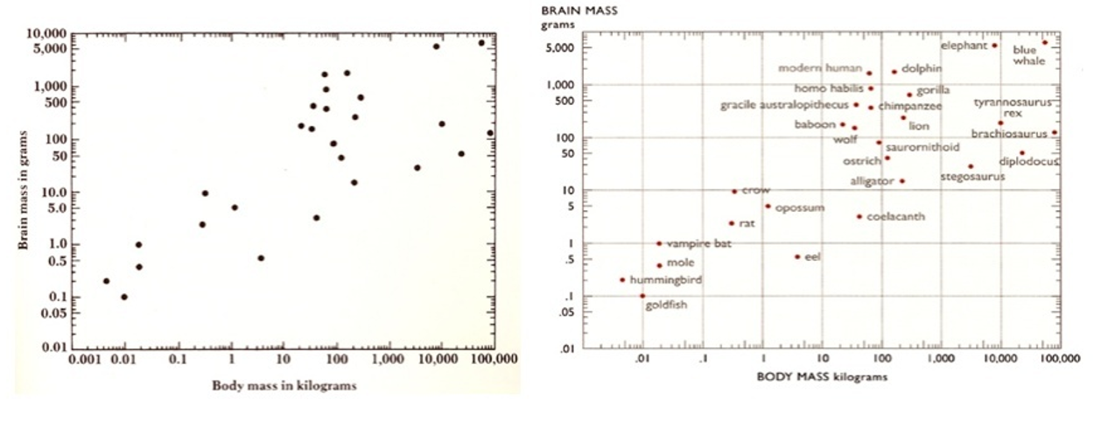
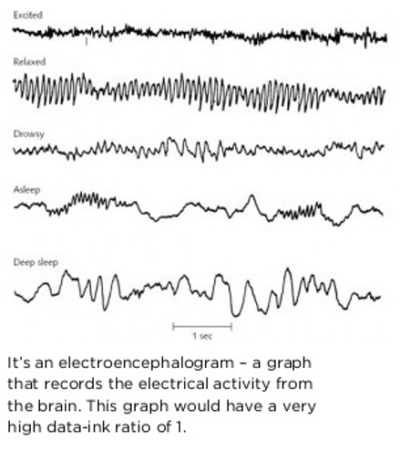
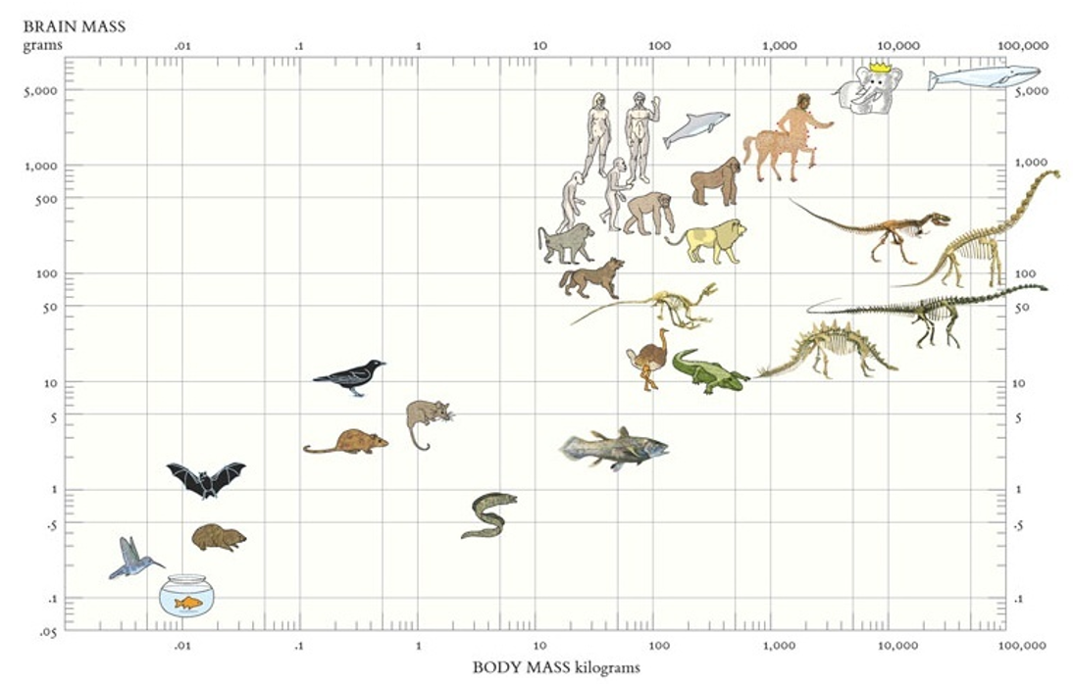
Maximize data ink

Slide 26
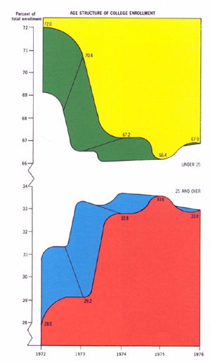
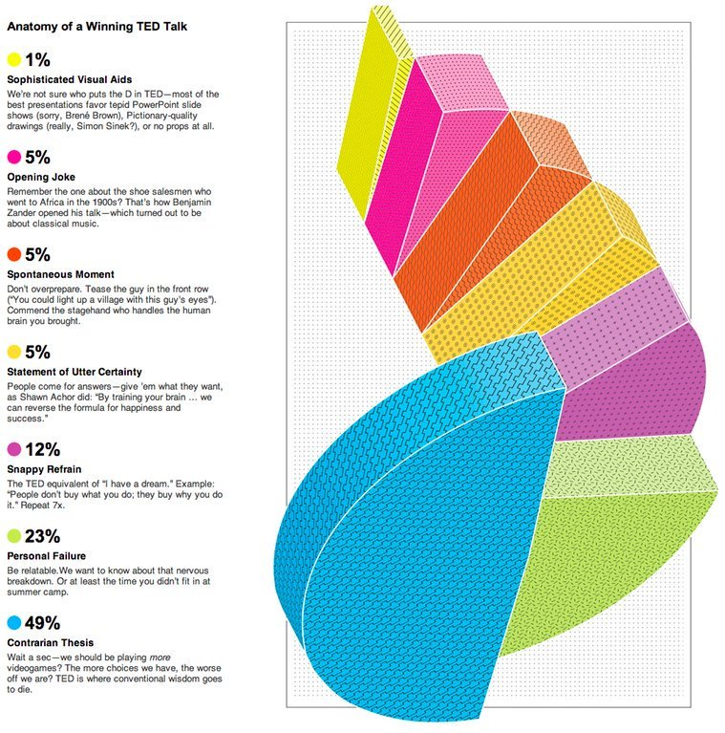
Avoid chart junk
The excessive and unnecessary use of graphical effects in graphs used to demonstrate the graphic ability of the designer rather than display the data

Slide 27
And now…something special Corporate chart junk

Slide 28
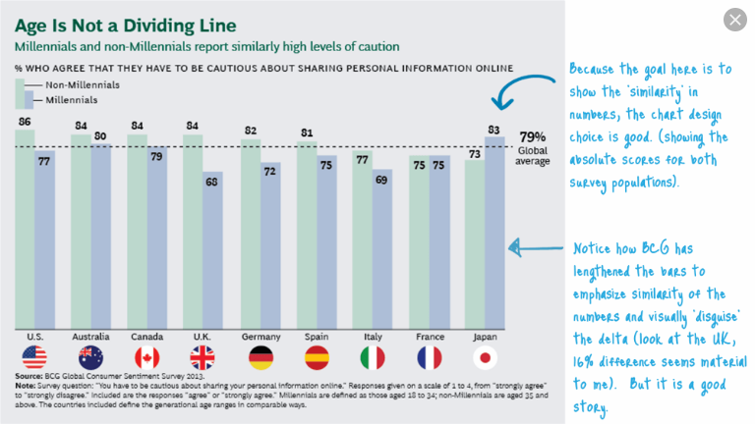
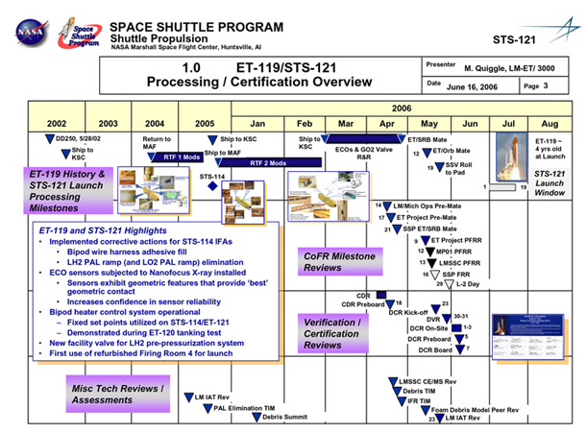
And now…something special Corporate chart junk

Slide 29
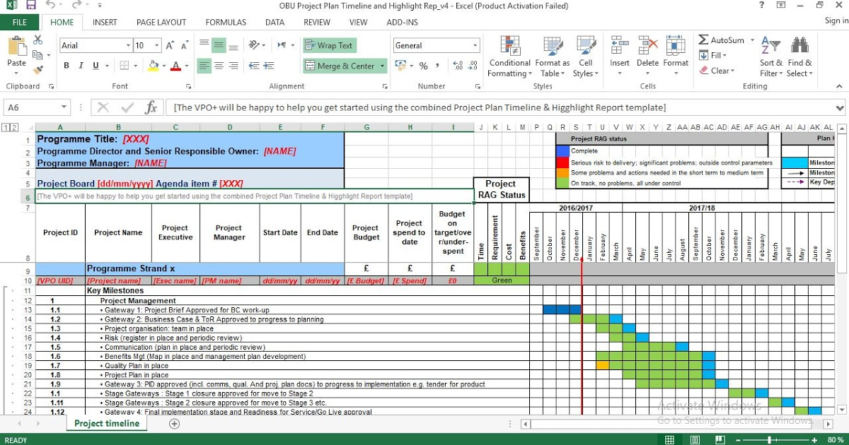
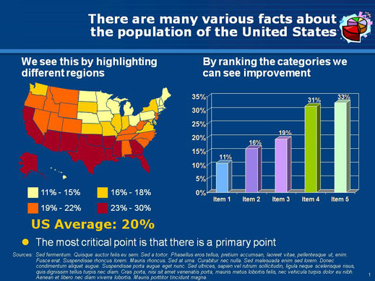
And now…something special Corporate chart junk

Slide 30
Closing thoughts
Take every chance to show a tangible object
Don’t use boxes or 3-D objects
When presenting - focus on two things - story and credibility
To clarify - add detail
Tell the audience what is important
A number provides information, but it doesn’t give context
You don’t need multiple corporate logos on every slide or graphics
If a summary is tough to write, your content is weak
Final part is Q&A, press conference style

Slide 31
Graphical form

Slide 32
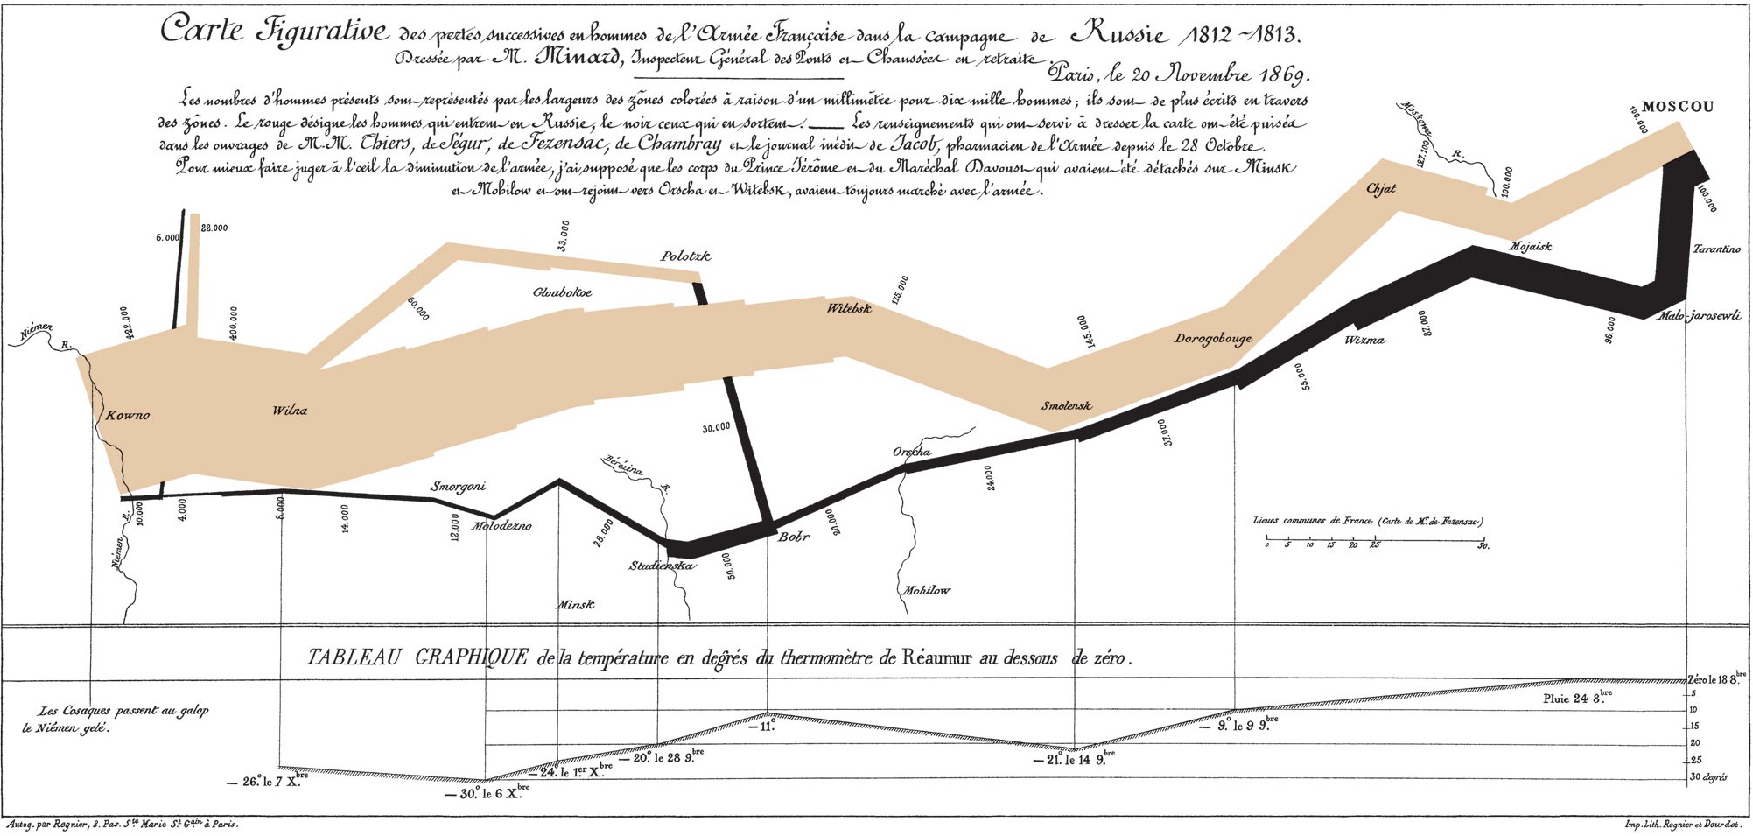

Slide 33
Finding the right graphic form
What do you want to accomplish?
Compare
See change
Reveal relationships
Envision temporal or spatial patterns
Try different graphic forms
Arrange the components to make it as easy as possible to extract meaning from it
Test the outcomes

Slide 34
The data visualization catalogue
By Severino Ribecca, https://datavizcatalogue.com/

Slide 35
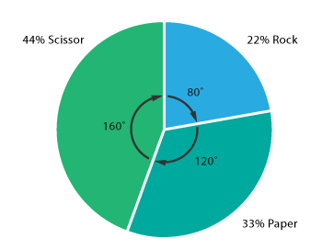
Parts of a whole & proportions
Pie chart
Displays part of a whole
Bad for proportion perception as human vision does not perceive well angle based proportions
Not suitable for accurate comparison

Slide 36
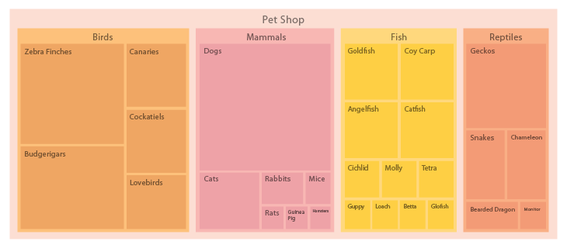
Parts of a whole & proportions
Treemap
Can display a hierarchy
Impractical with too many small segments
Impractical with too many hierarchy levels

Slide 37
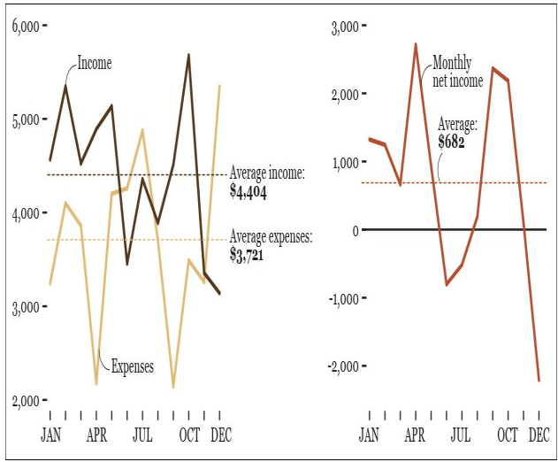
Plot what you want to show!

Slide 38
Graphical integrity

Slide 39
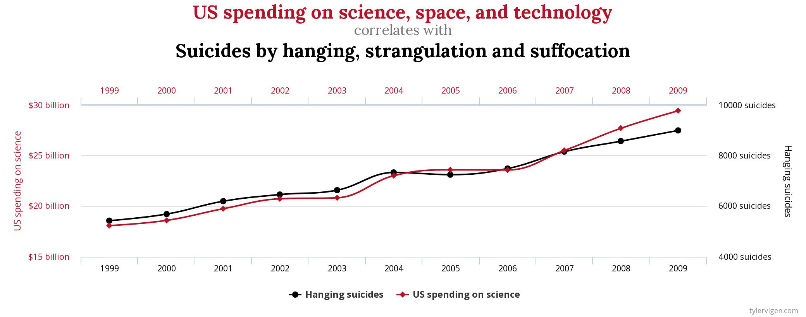
GIGO also applies to data graphics!

Slide 40
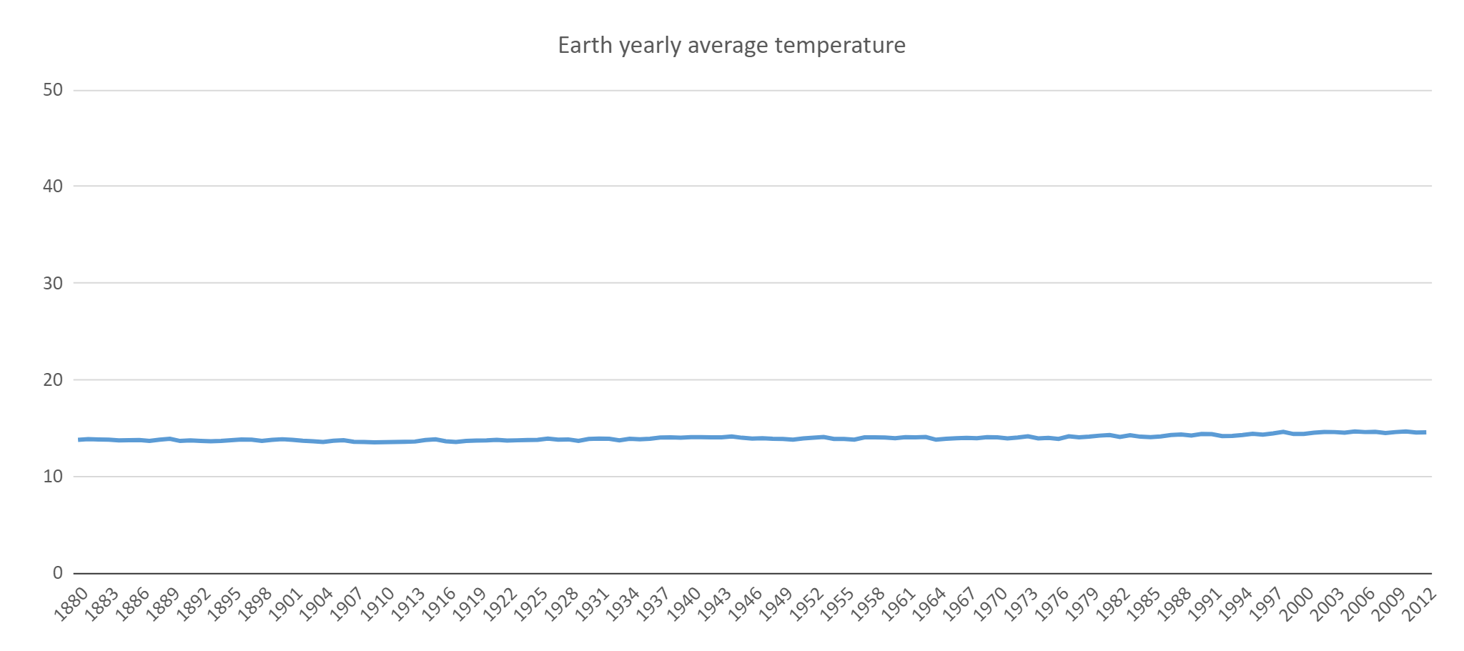
Misleading time series charts

Slide 41
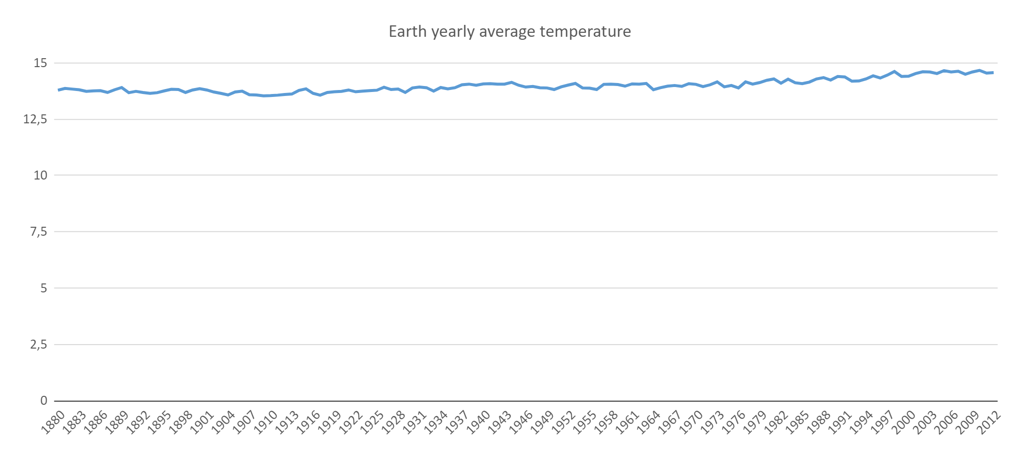
Misleading time series charts

Slide 42
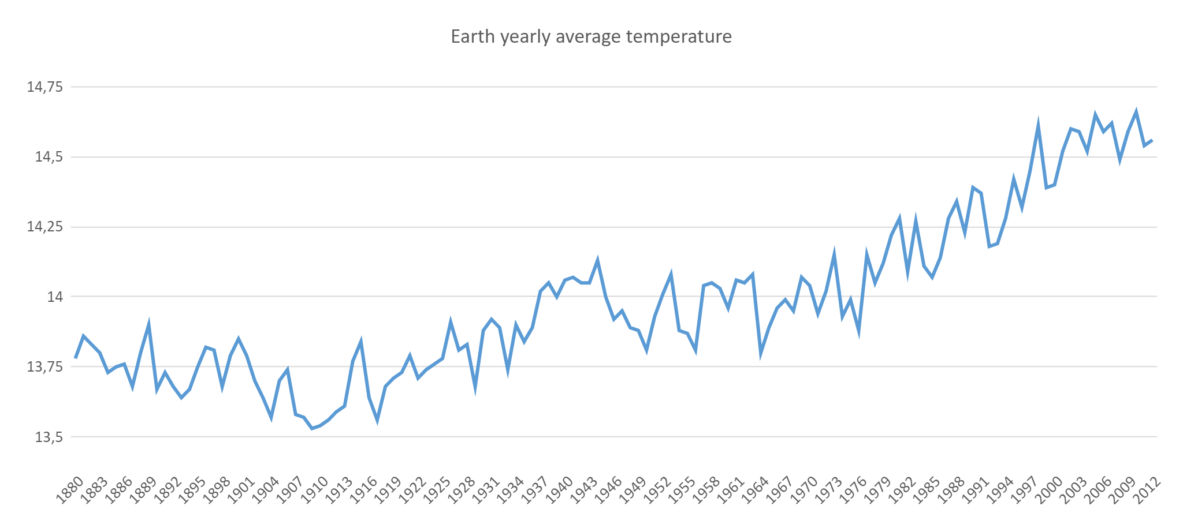
Misleading time series charts

Slide 43
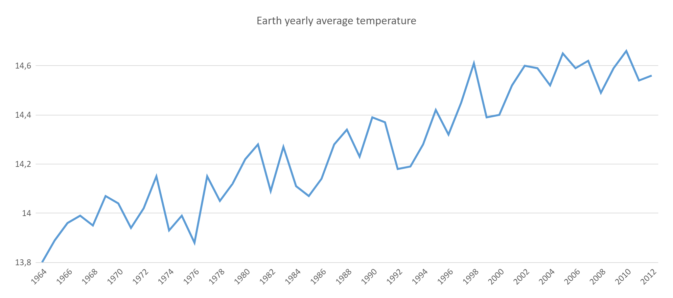
Misleading time series charts

Slide 44
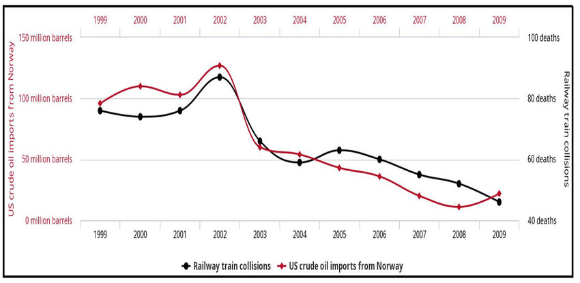
Correlation does not imply causation

Slide 45
The dimensionality principle
The number of information carrying dimensions should not exceed the number of dimensions in the data

Slide 46
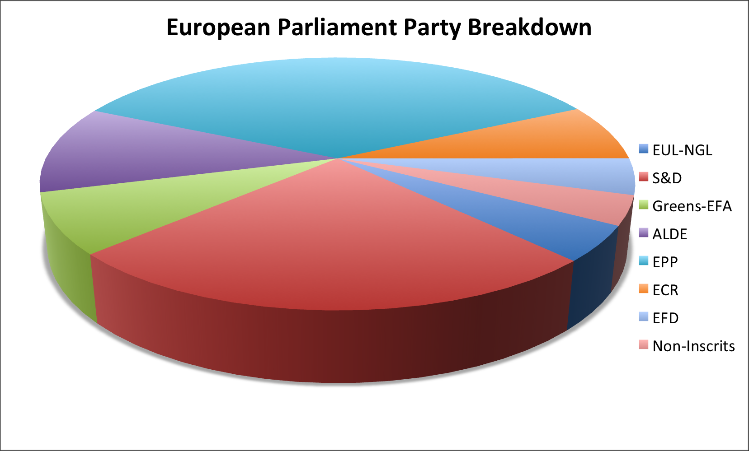
Dimensionality principle - example

Slide 47
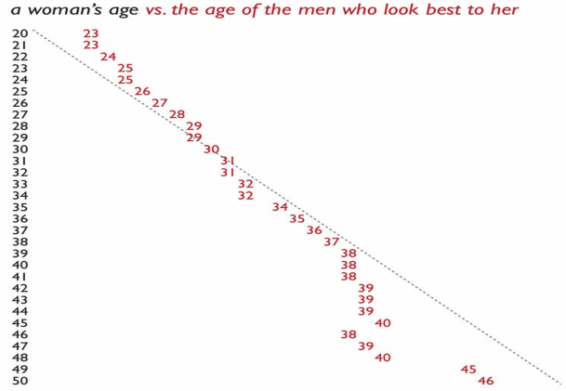
OKcupid women vs men age preferences

Slide 48
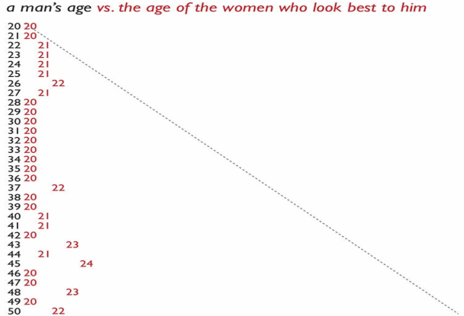
OKcupid women vs men age preferences

Slide 49
Dashboards

Slide 50
What is a dashboard?
Dashboards are visual displays
Dashboards display the information needed to achieve specific objectives
A dashboard fits on a single computer screen
Dashboards are used to monitor information at a glance
Dashboards have small, concise, clear, and intuitive display mechanisms
Dashboards are customized
A dashboard is a type of display, a form of presentation, not a specific type of information or technology

Slide 51
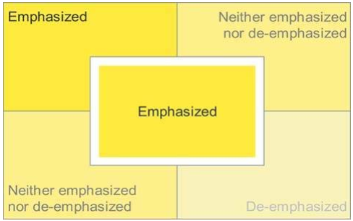
Location, location, location

Slide 52
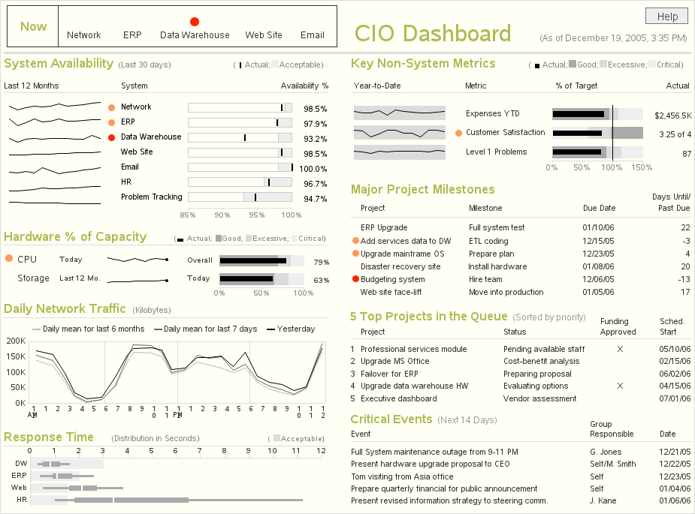

Slide 53
Lieterature

Slide 54
Literature
Edward R. Tufte - The Visual Display of Quantitative Information, 2nd Edition. Graphics Press, 2001.
Alberto Cairo - The Truthful Art. New Riders, 2016.
Stephen Few - Information Dashboard Design - The Effective Visual Communication of Data. O’Reilly, 2006.

Slide 55
Applied visualization
Finding the story in your data
Data design – best practices
MATPLOTLIB + SEABORN – WITH EXAMPLES

Slide 56
Finding the story in your data

Slide 57
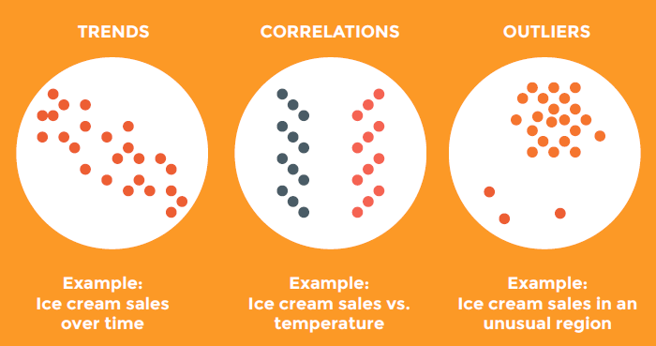
Usual data patterns

Slide 58
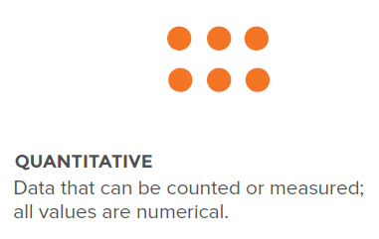
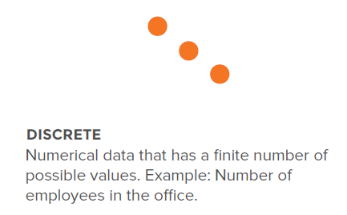
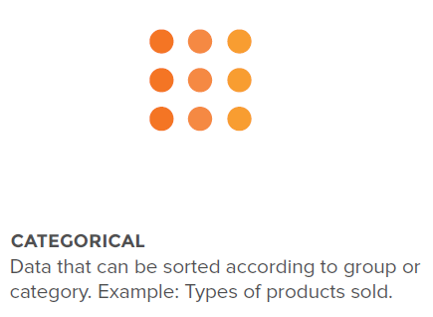
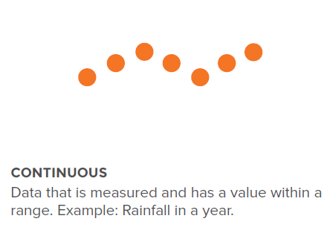
Know your data – data types
58

Slide 59
Know your data – data relationships

Slide 60
Know your data – data relationships

Slide 61
Best practices in data design

Slide 62
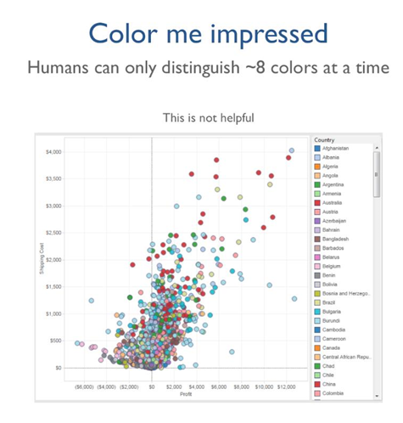
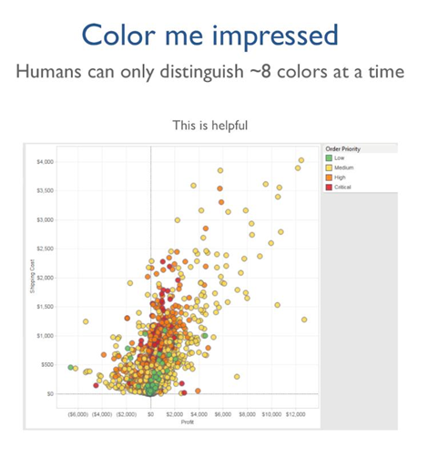
Best practices in data design

Slide 63
Best practices in data design

Slide 64
Best practices in data design

Slide 65
Best practices in data design

Slide 66
Matplotlib + Seaborn

Slide 67
Jupiter Notebook time or…

Slide 68
Next steps
Online courses
Literature
Q&A

Slide 69
Online courses
Coursera
PWC - Data Visualization with Advanced Excel
PWC - Data-Driven Decision Making
PWC - Effective Business Presentations with PowerPoint
Specialization - University of Michigan - Applied Data Science with Python
Applied Plotting, Charting & Data Representation in Python
Datacamp
Data Visualization for Everyone
Data Visualization with Python
…

Slide 70
Literature
Edward R. Tufte - The Visual Display of Quantitative Information, 2nd Edition. Graphics Press, 2001.
Alberto Cairo - The Truthful Art. New Riders, 2016.
Stephen Few - Information Dashboard Design - The Effective Visual Communication of Data. O’Reilly, 2006.
Wiley&Sons – Data Visualization with Python: Create an impact with meaningful data insights
Wiley&Sons – Data Visualization: Introduction to Data Visualization with Python, R and Tableau
Wiley&Sons – Tableau Your Data!: Fast and Easy Visual Analysis with Tableau Software, 2nd Edition
…

Slide 71
Q&A

